Slide 1
Biology in a Box
A science education outreach program brought to you by a partnership
between The University of Tennessee and the National Institute for Mathematical and Biological Synthesis
Visit us on the web at http://biologyinabox.utk.edu
Biology in a Box Team
Program Director/Author/Lead Editor: Dr. Susan E. Riechert (University of Tennessee)
Science Collaborators: Dr. Thomas C. Jones (East Tennessee State University), Dr. Stan Guffey (University of Tennessee)
Mathematics Collaborators/Editors: Dr. Suzanne Lenhart (NIMBioS), Kelly Sturner (NIMBioS), Lu Howard (University of Tennessee)
Outreach Coordinator: Dr. Lynn Champion (University of Tennessee)
Workshop Coordinators: Kathy DeWein (Austin Peay State University), Gale Stanley (Jacksboro Middle School)
Production/Assistant Editor: J.R. Jones (University of Tennessee)
Previous Contributors: Sarah Duncan, Communications (formerly with NIMBioS), Rachel Leander, Math Collaborator (formerly with NIMBioS)
This unit revised April 2013
Copyright 2012 by Biology in a Box, and the University of Tennessee. All materials in this unit and on the Biology in a Box web server (biologyinabox.utk.edu, eeb.bio.utk.edu/biologyinbox) may not be reproduced or stored in a retrieval system without prior written permission of the publisher, and in no case for profit.

Slide 2
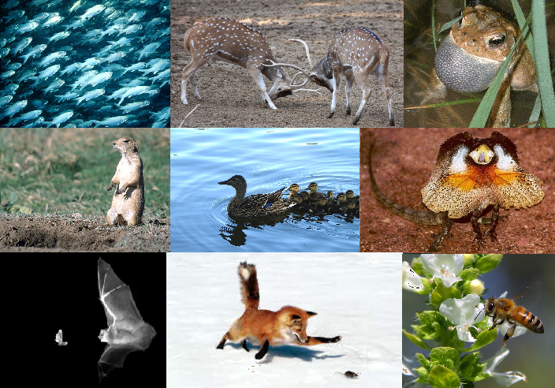

Slide 3
Homepage
Click on underlined text to jump to information and exercises!
Materials List
Introduction
Part I: The Senses
Exercise 1: The Tactile Sense
Exercise 2: Chemical Olfaction
Exercise 3: Vision
Exercise 4: Hearing is a Vibrational Sense
Part II: Environment & Learning
Exercise 5: Temperature Effects on Call Rates
Exercise 6: T-Maze Experiments
Exercise 7: Caching Food for Times of Famine
Suggested Reading
Links
Clicking the icon on other slides will bring you back to this page!

Slide 4
Materials List

Slide 5
Introduction
All behavior involves actions by organisms in response to particular situations.
Behavior thus involves responses to stimuli or cues.
Some of these stimuli may be
Internal – e.g. an empty stomach generating hunger, causing an animal to seek food
External – e.g. detection of a predator causing a rabbit to freeze in place
In order for an animal, to respond to internal and external cues, it also must have the means to detect these cues.
Organisms vary in the extent to which they utilize vision, hearing, smell and touch in detecting objects and events.
The senses, like actions, are also components of behavior.
Behavior is adaptive & can be inherited, or passed from parent to offspring.
All organisms exhibit behavior, though it is most important to animals that are able to move in complex ways.
In Part I, you will examine the various senses utilized by various animals, and their relative importance in various organisms.
In Part II, you will examine the roles of environmental influences and learning, and their contribution to behavior.

Slide 6
Part I: The Senses
Senses provide an animal access to external information.
Senses also filter information from the external environment, determining what an animal tunes into and what it does not.
We usually think in terms of the so-called "five senses“:
Touch
Taste
Smell
Hearing
Vision
However, there are additional senses. These include
perception of magnetic fields
perception of heat
perception of electricity

Slide 7
Part I: The Senses
There are also many variations of each of the individual senses mentioned on the previous slide.
Variability exists because sensory systems have developed for different functions.
Thus, different organisms sense the world in different ways.
For instance, humans largely utilize vision and hearing, while an earthworm or a fish is tuned primarily to vibrations and odors.
Click the name of an exercise below to jump to that exercise:
Exercise 1: The Tactile Sense
Exercise 2: Chemical Olfaction
Exercise 3: Vision
Exercise 4: Hearing is a Vibrational Sense

Slide 8
Exercise 1: The Tactile Sense
Other senses are limited to special organs in the body, such as vision with eyes, hearing with ears, smell with the nose (in mammals and birds at least).
However, the tactile sense (touch) is perceived by receptors all over the body just below the surface layer of skin in the dermis layer.
Here thousands of sensory cells (nerve endings) detect pressure/weight, temperature, pain, and other lesser stimuli.
Locations that are more sensitive to external cues (your fingertips, lips, and tongue, for example) have large concentrations of these nerve endings.
Why do you think this might be the case?
In these exercises, you will determine how well your sense of touch works, as well as learn about how other animals use this sense.

Slide 9
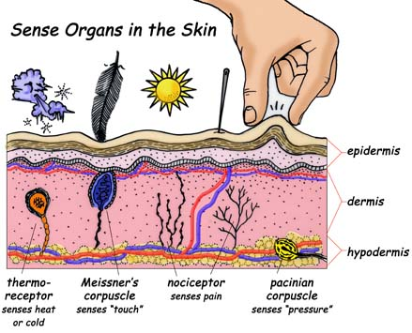
Exercise 1: The Tactile Sense
Diagram of various receptor cells in human skin. Amsel, Sheri. “Special Senses.” Touch. Exploring Nature Educational Resource. © 2005 - 2012.

Slide 10
Exercise 1: The Tactile Sense
Click the underlined text below to jump to a particular exercise:
Exercise 1.1: The Tactile Box (Grades K-12)
Exercise 1.2a: What is the object in my box? (Grades K-3)
Exercise 1.2b: What is the object in my box? (Grades 4-12)
Exercise 1.3: The Black Box: How Science Works (Grade 3-12)

Slide 11
Exercise 1.1: The Tactile Box
Divide into groups of 4-5 students each.
Your teacher will provide each group with a tactile box. Do not peek inside the hole on top!
Note that one side of the box has an opening that is masked by a sheet of foam with cuts in it. This will allow you to place one or more fingers inside the box without seeing into it. On the inside of the box, there are different textures on 5 surfaces (all four inner sides, and the inner bottom) of the box:
One surface will feel rough or prickly.
One surface will feel soft or fluffy.
One surface will feel smooth.
One surface will feel sticky.
One surface will feel bumpy.
Your goal is to find each of these surfaces by using only your sense of touch.

Slide 12
Exercise 1.1: The Tactile Box
Slip your hand (in the case of larger wooden boxes) or a few fingers (in the case of smaller metal boxes) into the hole on the top of the box. Don't try to peek inside!
Touch one of the inner surfaces and run your hand or fingers along it.
Take note of how this particular surface feels.
Next, look at the picture on the outside of the box that corresponds to the surface you are touching.
Make a chart like the one shown on the following slide (or your teacher will provide one for you).
Find the picture on the chart that matches picture on the outside surface that you just felt. Write one of the words (fluffy, bumpy, scratchy, sticky, or smooth) that best describes the texture beside the matching picture on the chart.

Slide 13
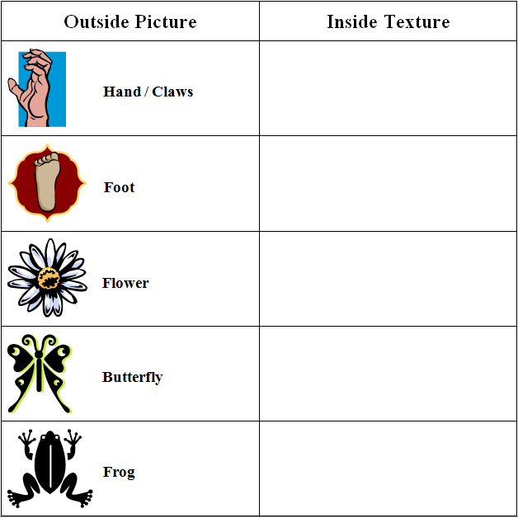
Exercise 1.1: The Tactile Box
Students that do not read can draw descriptive pictures of textures:
Bunny = soft
Cucumber = bumpy
Porcupine = prickly
Honey = sticky
Butter = smooth
Alternatively, they can cut and paste photocopied pictures of these items (on p. 5 of the workbook) on their chart.

Slide 14
Exercise 1.1: The Tactile Box
Once you have determined done this for one inner surface, go on to each of the other walls.
Fill in your chart as you work until you have examined all of the wall coverings in the box.
Compare your results with other students in your class.
Finally, check your chart against the answers on the next slide.

Slide 15
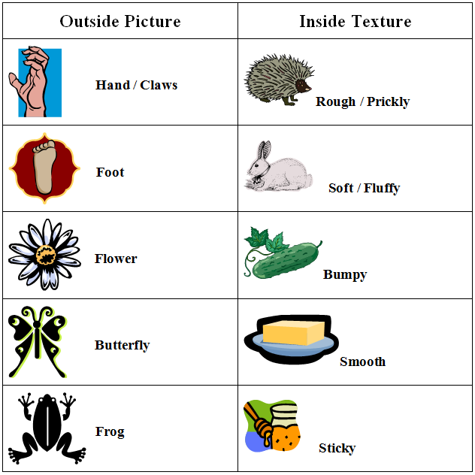
Exercise 1.1: The Tactile Box

Slide 16
Exercise 1.2a: What Is the Object in My Box? (Grades K-3)
In Exercise 1.1, you decided what different surfaces feel like.
Animals also use the sense of touch to identify objects.
In this exercise, you will also use your sense of touch to identify mystery objects.
You will also learn a little about probability, and how it is important to science, as well as many other fields.
When we talk about the chance that a particular event will happen, we are talking about probability.
We hear about the chance of rain, the chance of snow, or the chance that any particular weather event will happen.
That means that we are hearing about the probability of a particular weather condition occurring.
We also hear about the chance of winning the lottery, which is really the probability that we will win.

Slide 17
Exercise 1.2a: What Is the Object in My Box? (Grades K-3)
Making predictions about the likelihood of a certain event happening is a very important skill, and helps us in many areas of our lives.
Aside from just information about the weather and the lottery, understanding probability is very useful in in many other ways, such as studying health, transportation safety, sports, and protecting the environment, just to name a few.
First let’s further explore your tactile sense.
Form a line to approach the front of the classroom.
When it is your turn, go to the front of the room one at a time with your hands behind your back, and turn to face the class.
The teacher will place an object in your hand to feel but not see.
Go back to your desk without talking to others.
After everyone has had a chance to feel the object, your teacher will poll the class as to what everyone thought the object was.
Once a list of potential objects has been made and all students have had the opportunity to discuss the characteristics of the object that gave them a clue as to what it was, the object will be shown to the class.

Slide 18
Exercise 1.2a: What Is the Object in My Box? (Grades K-3)
Now let’s repeat this game, but with a slight twist. This time you will have the opportunity to examine all of the objects that might possibly be given to you before you feel the mystery object.
Divide into small groups of around 4 students each.
Your teacher will provide each group with a container (the “White Box” container) of 11 objects, including the following items: a cork, a cotton ball, a crayon, a marble, a metal ball, a paper clip, a penny, a poker chip, a rubber ball, a rubber band, and a toothpick.
Your teacher will also place one of the objects found in the White Box you have to look at in the tactile box your group will receive. It is your job to determine what is in this mystery box. Do not peek or reach into the tactile box given to you!

Slide 19
Exercise 1.2a: What Is the Object in My Box? (Grades K-3)
Look carefully at each of the items in the provided “White Box” container. What do you notice about each item? The words you use to describe the items, “shiny,” “smooth,” “round,” etc., are called characteristics, or sometimes they are called attributes.
Look at the geometric characteristics (shapes) of each object. For example, is the object ball-shaped, flat, rectangular, round, etc.? Compare your observations of the different objects.
Now examine the objects for other characteristics. How do they feel? Are they smooth, rough, soft, or hard? Are some heavier than others?
Now select two characteristics for sorting the items into two separate groups. Make a two-column chart with one of the chosen characteristics at the top of each column. Sort the items in the White Box and write the names of the items in the column that best describes each item.

Slide 20
Exercise 1.2a: What Is the Object in My Box? (Grades K-3)
Put all items back together in one group. Sort the items a second time, only this time using two different characteristics. Write down the second set of characteristics and the items in each group as done in the first sorting.
Discuss with your classmates and teacher about your choices of characteristics and how those characteristics could help you determine which object is in a team’s tactile box. In discussing these characteristics, consider the following questions:
Which characteristics will be helpful to you when you are trying to determine which object is in the box? If so, how will they help you? If not, why not?
Why did you choose particular characteristics? Did all items clearly fit into one or the other group? Were your characteristics "opposites" (hard versus soft, smooth versus rough, etc.)?

Slide 21
Exercise 1.2a: What Is the Object in My Box? (Grades K-3)
Now repeat the mystery object tactile game a second time with the information you have gained about the characteristics of the potential objects available to you.
You should again form a line to approach the front of the room one at a time, again with your hands behind your back, and turning to face the class.
The teacher will again place an object in your hand to feel but not see.
Go back to your desk without talking to others.
After everyone has had the opportunity to feel the object, your teacher will again poll the class as to what everyone thought the object was.
Once a list of potential objects has been made and all students have had the opportunity to discuss the characteristics of the object that gave them a clue as to what it was, the object will be shown to the class.
Discuss with your class whether this version of the game was easier for you. If so, why do you think that is the case?

Slide 22
Exercise 1.2b: What Is the Object in My Box? (Grades 4-12)
Divide into small groups of around 4 students each.
Your teacher will provide each group with a container (the “White Box” container) of 11 objects, including the following items: a cork, a cotton ball, a crayon, a marble, a metal ball, a paper clip, a penny, a poker chip, a rubber ball, a rubber band, and a toothpick.
Your teacher will also place one of the objects found in the White Box you have to look at in the tactile box your group will receive. It is your job to determine what is in this mystery box. Do not peek or reach into the tactile box given to you!

Slide 23
Exercise 1.2b: What Is the Object in My Box? (Grades 4-12)
Look carefully at each of the items in the provided “White Box” container. What do you notice about each item? The words you use to describe the items, “shiny,” “smooth,” “round,” etc., are called characteristics, or sometimes they are called attributes.
Look at the geometric characteristics (shapes) of each object. For example, is the object ball-shaped, flat, rectangular, round, etc.? Compare your observations of the different objects.
Now examine the objects for other characteristics. How do they feel? Are they smooth, rough, soft, or hard? Are some heavier than others?
Now select two characteristics for sorting the items into two separate groups. Make a two-column chart with one of the chosen characteristics at the top of each column. Sort the items in the White Box and write the names of the items in the column that best describes each item.

Slide 24
Exercise 1.2b: What Is the Object in My Box? (Grades 4-12)
Put all items back together in one group. Sort the items a second time, only this time using two different characteristics. Write down the second set of characteristics and the items in each group as done in the first sorting.
Discuss with your classmates and teacher about your choices of characteristics and how those characteristics could help you determine which object is in a team’s tactile box. In discussing these characteristics, consider the following questions:
Which characteristics will be helpful to you when you are trying to determine which object is in the box? If so, how will they help you? If not, why not?
Why did you choose particular characteristics? Did all items clearly fit into one or the other group? Were your characteristics "opposites" (hard versus soft, smooth versus rough, etc.)?

Slide 25
Exercise 1.2b: What Is the Object in My Box? (Grades 4-12)
Put all items back together in one group. Sort the items a second time, only this time using two different characteristics. Write down the second set of characteristics and the items in each group as done in the first sorting.
Discuss with your classmates and teacher about your choices of characteristics and how those characteristics could help you determine which object is in a team’s tactile box. In discussing these characteristics, consider the following questions:
Which characteristics will be helpful to you when you are trying to determine which object is in the box? If so, how will they help you? If not, why not?
Why did you choose particular characteristics? Did all items clearly fit into one or the other group? Were your characteristics "opposites" (hard versus soft, smooth versus rough, etc.)?

Slide 26
Exercise 1.2b: What Is the Object in My Box? (Grades 4-12)
Now repeat the mystery object tactile game a second time with the information you have gained about the characteristics of the potential objects available to you.
You should again form a line to approach the front of the room one at a time, again with your hands behind your back, and turning to face the class.
The teacher will again place an object in your hand to feel but not see.
Go back to your desk without talking to others.
After everyone has had the opportunity to feel the object, your teacher will again poll the class as to what everyone thought the object was.
Once a list of potential objects has been made and all students have had the opportunity to discuss the characteristics of the object that gave them a clue as to what it was, the object will be shown to the class.
Discuss with your class whether this version of the game was easier for you. If so, why do you think that is the case?

Slide 27
Exercise 1.2b: What Is the Object in My Box? (Grades 4-12)
How likely do you think it is that a ball-shaped object (sphere) will be placed in your hand?
How likely do you think it is that a flat object will be placed in your hand? How many individual outcomes are possible, knowing that one object will be placed in your hand?
These are questions that can be answered by simple probability.
When we think about how likely, or how probable, it is that a certain object will be given to us, we have to first think about all the possible outcomes.
We know there are 11 possibilities, because there are 11 different objects that could be chosen as the one placed in your hand.
For example, the probability that it is a rubber band is 1 out of 11, because only one of the 11 objects is a rubber band.
The probability of a sphere being the object is 4 out of 11, because 4 of the 11 objects (cotton ball, marble, metal ball, rubber ball) are spheres.

Slide 28
Exercise 1.2b: What Is the Object in My Box? (Grades 4-12)

Slide 29
Exercise 1.3: The Black Box: How Science Works
What is science?
Science can be defined as any approach that involves the gaining of knowledge to explain the natural world.
Scientist test ideas by gathering evidence.
A popular opinion of science has been that it is done in a very specific way, always following a set number and order of steps.
This is not the case.
Science actually is a very creative endeavor and consists of the interaction of elements, such as exploration and discovery, community interaction, and contributions to society, while still maintaining the central notion of testing ideas.

Slide 30
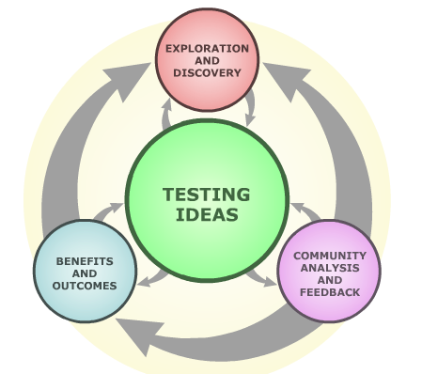
Exercise 1.3: The Black Box: How Science Works
Below is an illustration of the various elements of science (from The University of California Museum of Paleontology in Berkeley).
Note that testing ideas is the central element of science!

Slide 31
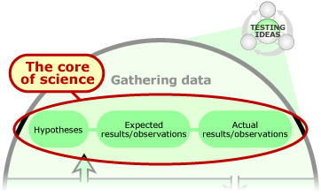
Exercise 1.3: The Black Box: How Science Works
In this series of exercises, collectively referred to as ‘Black Box’ experiments, you will first focus on the central principle of testing ideas, which is detailed in the figure below:
However, as you progress through these experiments, you will expand your view of science, and how other different elements of science (such as discovery, community interaction, and benefits to society) can interact and contribute to the exciting field of science as a whole.

Slide 32
Exercise 1.3: The Black Box: How Science Works
When it comes to testing ideas, you will often hear about the testing of a particular hypothesis.
Hypotheses are referred to as "educated guesses," which are potential explanations of a particular natural phenomenon.
For example, let's say you have two flower beds (one in your front yard, and the other in the back yard) in which you have planted seeds from the same seed packet.
When you examine the plants that have been produced by the seeds, you observe that those in the front yard flower bed are much taller than those in the back yard.
You could come up with several possible explanations (hypotheses) as to why this might be the case.
For example, you might argue that the flower bed in the front yard gets more sun, gets or retains more moisture, has better soil quality, or even some combination of these and other factors.
Each of these explanations is an idea that could be tested.

Slide 33
Exercise 1.3: The Black Box: How Science Works
Let’s assume, that you decide to test your hypothesis that the flowers in the front yard are taller because you think the front yard receives more light.
What kinds of evidence would you gather to test this idea and would you make an assumption about some aspect of your hypothesis that you will not be testing directly?
(By assumption, we refer to something that is accepted as fact without proving it first hand).
Well, first, you could do something simple, such as placing light meters in each flower bed to record the amount and intensity of light that each received throughout a particular time period.
If in comparing the light records between flower beds you find that the light meter readings from the front yard bed reflect, on average greater light exposure than those collected from the back yard bed, then your hypothesis is supported.

Slide 34
Exercise 1.3: The Black Box: How Science Works
The assumption you might then make based on your knowledge of the factors influencing plant growth is that increased light is contributing to taller plants in the front yard.
You could actually test this assumption directly by setting up an experiment with a new package of seeds of that flower species, growing them under different light levels.
In this case, you would predict, before the flowers started to grow, that the seeds exposed to more light would grow taller.
In the previously described experiments, you would be gathering evidence to test your hypothesis that light exposure differences may lead to differences in plant growth.
The results of tests of ideas may either support or fail to support a particular hypothesis.
If the results fail to support the original hypothesis, a new, revised hypothesis can then be formed and tested.

Slide 35
Exercise 1.3: The Black Box: How Science Works
If your hypothesis is supported by the results, that doesn't necessarily mean a stopping point has been reached.
Consider the following. Based on your experiments, you found that
There is a correlation between the amount of light the two sections of your yard receives and plant height
Light contributes to plant growth .
However, this does not necessarily mean that different light levels has caused the difference in plant heights you observed between your front and back yards.
Some other factor, such as differences in soil composition or frequency differences in the watering of the two flower beds might be the prominent contributing factor.

Slide 36
Exercise 1.3: The Black Box: How Science Works
When hypotheses are continuously supported when subjected to very many tests, may become part of a scientific theory.
It is very important to note that non-scientists often use the word "theory" to mean "just a guess."
However, in science, the word "theory" has a very different, very specific meaning: "a well-substantiated explanation of some aspect of the natural world that can incorporate facts, laws, inferences, and tested hypotheses" (National Center for Science Education 2008).

Slide 37
Exercise 1.3: The Black Box: How Science Works
In the following series of exercises, you will utilize various elements of science, as well as the laws of probability to help you decide on the possible identity of one or more mystery objects (from a set of 11 potential objects) in a container (the “Black Box”) without opening the container first.
In science, the term “black box” is often used to refer to something unknown.

Slide 38
Exercise 1.3: The Black Box: How Science Works
Under Exercise 1.3a, you will use the senses available to you in formulating hypotheses (ideas) about the identity of the object(s) in the Black Box.
In Exercise 1.3b, you will compare your success in identifying the two objects through the use of the scientific principle of testing ideas versus the success you would have in merely guessing what is in the Black Box. You will apply the rules of mathematical probability in determining what number of guesses would be required to correctly guess the identity of the unknown item(s).
Exercises 1.3c & 1.3d are further extensions of the previous exercises, and are intended to provide you with an even more realistic understanding of how science works than the illustrations provided by Exercises 1.3a &b.

Slide 39
Exercise 1.3: The Black Box: How Science Works
Under Exercise 1.3a, you will use the senses available to you in formulating hypotheses (ideas) about the identity of the object(s) in the Black Box.
In Exercise 1.3b, you will compare your success in identifying the two objects through the use of the scientific principle of testing ideas versus merely guessing what is in the Black Box. You will apply the rules of mathematical probability in determining what number of guesses would be required to correctly guess the identity of the unknown item(s).
Exercises 1.3c & 1.3d are further extensions of the previous exercises, and are intended to provide you with an even more realistic understanding of how science works.
ONE RULE APPLIES THROUGH ALL OF THESE EXERCISES: NO PEEKING INTO THE BLACK BOX until you commit your hypothesis to paper, announce it to your class, and you are instructed to open it!

Slide 40
Exercise 1.3: The Black Box: How Science Works
Click an underlined exercise title below to jump to that particular exercise:
Exercise 1.3a.1: Black Box Trial 1: Exploration & Testing Ideas (Grades 4-5)
Exercise 1.3a.2: Black Box Trial 1: Exploration & Testing Ideas (Grades 6-12)
Exercise 1.3b.1: Using Simple Probability (Grades 4-5)
Exercise 1.3b.2: The Rules of Probability (Grades 6-12)
Combinations, Permutations, & Ways of Selecting Objects
Exercise 1.3c: Black Box Trial 2: Community Feedback & Analysis (Gr. 6-12)
Exercise 1.3d: Black Box Trial 3: Outcomes & Benefits (Grades 6-12)

Slide 41
Exercise 1.3a.1: Black Box Trial 1: Exploration & Testing Ideas
NOTE TO TEACHERS: Make sure each “Black Box 1.3a” tin has only one item inside it for grades 4-5, but two different items for grades 6-12.
Divide into teams. (Six sets of this experiment are available).
Each team should have a container labeled as the “White Box”, a container labeled “Black Box 1.3a,” and an empty clear plastic container.
NOTE: The Black Box container should not be opened during the course of this experiment.
Open the “White Box” container. Check to see that there are 11 unique items in this container. If not, contact your teacher for replacements.
DO NOT TOUCH OR OTHERWISE INTERACT WITH YOUR GROUP'S BLACK BOX AT THIS POINT!

Slide 42
Exercise 1.3a.1: Black Box Trial 1: Exploration & Testing Ideas
Examine each of the 11 objects in the white box, paying particular attention to their geometric attributes (shapes).
Note whether each object is spherical (ball-shaped), flat, etc.
Try to think of other characteristics that might help identify the mystery item in the Black Box without first opening it!
How about the sound an object makes in the tin container (soft or loud, a thud or a clink, etc.), how heavy it feels in your hand relative to other objects etc.
You may wish to make observations of the characteristics of items placed in the White Box one at a time to give you an idea on what you might observe in the Black Box later.
You can place the other White Box items in the clear plastic container to keep them from rolling off your desk.
Be creative in devising a testing plan! What characteristics will you examine and how will you do this?

Slide 43
Exercise 1.3a.1: Black Box Trial 1: Exploration & Testing Ideas
Make a table listing each of the 11 objects as rows in a table like the one shown below for comparing US coins. The column headings are characteristics or attributes that you have recorded for each coin type. For instance, a penny is round and flat (characteristic 1), coppery in color (characteristic 2) and the third largest of the coins listed (characteristic 3).
Item | Characteristic 1 Shape | Characteristic 2 Color | Characteristic 3 Size ( 1 = largest) | Etc.
Penny | Round, flat | Coppery | 3
Nickel | Round, flat | Silver | 2
Dime | Round, flat | Silver | 4
Quarter | Round, flat | Silver | 1

Slide 44
Exercise 1.3a.1: Black Box Trial 1: Exploration & Testing Ideas
Examine the table that you have constructed that lists the characteristics of each of the potential items from the White Box that could be in your Black Box.
You have just used one element of science (exploration) to explain some aspect of the natural world (the identity of an object in your Black Box).
Now take a moment to again think about the central focus of science which is to test ideas.
You know that there are actually 11 different objects that could possibly be in the Black Box.
Therefore, there are a total of 11 different ideas (hypotheses) that you can test!
Make a list of all 11 possible hypotheses for this experiment, each in the form “There is a _______ in the Black Box.”

Slide 45
Exercise 1.3a.1: Black Box Trial 1: Exploration & Testing Ideas
Beside each hypothesis, make one or more predictions as to what you might observe about the Black Box (again, without opening it!) if that hypothesis is correct, using some of the characteristics you used in the table you have constructed.
For example, if the particular hypothesis is “There is a cotton ball in the Black Box,” and the traits you used were the sound and perceived weight of the 11 objects from the White Box, a logical prediction might be “If there is a cotton ball in the Black Box, the Black Box will be very light, and not make a noise when shaken.”
After you have made a list of all possible hypotheses and predictions based on the characteristics you used in constructing your table, it is time to put each of these hypotheses to the test!

Slide 46
Exercise 1.3a.1: Black Box Trial 1: Exploration & Testing Ideas
Beside each hypothesis, make one or more predictions as to what you might observe about the Black Box (again, without opening it!) if that hypothesis is correct, using some of the characteristics you used in the table you have constructed.
For example, if the particular hypothesis is “There is a cotton ball in the Black Box,” and the traits you used were the sound and perceived weight of the 11 objects from the White Box, a logical prediction might be “If there is a cotton ball in the Black Box, the Black Box will be very light, and not make a noise when shaken.”
After you have made a list of all possible hypotheses and predictions based on the characteristics you used in constructing your table, it is time to put each of these hypotheses to the test!
Using the cotton ball example, you could test your prediction by picking up the Black Box and shaking it. If it does not feel very heavy, and does not make a sound, that supports your initial hypothesis. However, be aware that other hypotheses regarding the contents may have similar predictions!

Slide 47
Exercise 1.3a.1: Black Box Trial 1: Exploration & Testing Ideas
If when you picked up the Black Box, it felt heavy and made a clanging sound when shaken, this does not match your initial prediction.
You must then revise your hypothesis.
Using your table of attributes of each possible object, as well as your list of hypotheses and predictions, draw a line through each hypothesis whose predictions are not met by your tests on the Black Box.
You should be able to eliminate several hypotheses in this way.
Did you have more than one hypothesis that was still supported after your tests on the Black Box?
If so, examine all the White Box items again, and see if you can come up with any other traits that might help you further narrow down the possible identity of the Black Box object without opening it yet.

Slide 48
Exercise 1.3a.1: Black Box Trial 1: Exploration & Testing Ideas
In the end, decide as a team, what the object within the Black Box may be and prepare your statement as to the evidence that you have gathered in support of this hypothesis.
DO NOT OPEN THE BLACK BOX YET!
After all teams have come to a decision on the identity of their mystery objects, your teacher will have each team tell the class what your conclusion is and how you came to arrive at that conclusion.
Your team will then open your Black Box. Were you correct?
One of you or your teacher should record on the board the number of teams that correctly identified the objects in their Black Boxes, as you will use this information in comparing the probability of obtaining a correct answer to a question posed through use of scientific practices versus simply guessing.

Slide 49
Exercise 1.3a.2: Black Box Trial 1: Exploration & Testing Ideas
NOTE TO TEACHERS: Make sure that each “Black Box 1.3a” tin has TWO different items from the 11 possible items inside it when using this exercise for grades 6-12. Also check to see that the White tin has the following 11 unique items in it: a toothpick, crayon, paper clip, rubber ball, metal ball, cotton ball, rubber band, marble, penny, poker chip, and a cork. There are six sets of this exercise available.
Split into small groups of students. All of the students within each ‘team’ formed will collaborate to determine which two mystery objects they have received.
Each group should be given one tin labeled as the White Box, a second tin labeled “Black Box 1.3a”, and one of the clear plastic containers (which can be used to keep White Box objects not in use from rolling off of desks/tables).
DO NOT TOUCH OR OTHERWISE INTERACT WITH YOUR GROUP'S BLACK BOX AT THIS POINT!

Slide 50
Exercise 1.3a.2: Black Box Trial 1: Exploration & Testing Ideas
Refer to Figure 2 (p. 12 in the workbook for this unit) that illustrates the elements of science with respect to testing ideas.
Examine the objects in the White Box, listing them on a sheet of paper or on the board at the front of the room so that you may consult the list as your investigation proceeds.
As a group, you should consider how you will approach the problem scientifically, using the scientific element of exploration.
For example you might choose to explore the characteristics (sounds, mass) of the Black Box itself and record these.
Your hypothesis would be that the objects would have to have a particular sound, weight, and/or behavior relative to one another.
Examples of alternative approaches include exploring the behavior of the 11 objects, individually, or in pairs in the White Box tin, and then making predictions about how the objects should sound etc.) if they were in the Black Box.

Slide 51
Exercise 1.3a.2: Black Box Trial 1: Exploration & Testing Ideas
Write the testing procedures you plan to use on a sheet of paper.
Start the process, remembering to keep in mind the central principle of testing ideas (Figure 2)!
As you gain information through exploration, begin making a list of hypotheses and assumptions under each of the hypotheses as you progress.
Record the steps you have taken throughout your investigation.
Finally record what your team concludes is in the Black Box, but do not open the Black Box yet!

Slide 52
Exercise 1.3a.2: Black Box Trial 1: Exploration & Testing Ideas
When finished, each team should report to the class:
the approach they have taken to the problem,
the hypotheses they constructed,
the steps they used to test their hypotheses,
revisions to hypotheses inspired by the testing process,
and finally, what two objects they feel are in the Black Box and why.
Now open the Black Box and check to see if you were correct.
Tally the number of teams that correctly obtained the two items present in their Black Box versus the number that failed to obtain the identity of both items on the board.
Calculate the proportion of teams that correctly identified both unknown objects. If three of six teams obtained the correct pair of items, your success would have been 3/6 =1/2 = 0.5 = 50%.

Slide 53
Exercise 1.3b.1: Using Simple Probability (Grades 4-5)
Suppose that instead of using the exploration element of science to assist you in testing ideas, you just guessed which item was in your Black Box without interacting with it in any way.
Would you have done as well?
Probably not!
The reason is that, although using the exploration element of science to inspire ways of testing the identity of the objects in the Black Box may not have completely determined which objects were in the Black Box, it helped you to narrow the list of possibilities.
On the other hand, guessing involves chance.
When we talk about the chance that a particular event will happen, we are talking about probability.

Slide 54
Exercise 1.3b.1: Using Simple Probability (Grades 4-5)
When we hear about the chance of rain, the chance of snow, or the chance that any particular weather event will happen, we are hearing about the probability of a particular weather condition occurring.
We also hear about the chance of winning the lottery, which is really the probability that we will win, or how likely we are to win.
Making predictions about the likelihood of a certain event happening is a very important skill, and helps us in many areas of our lives.
Aside from useful information about the weather and the lottery, understanding probability is very useful in studying health and disease, transportation safety, sports, and protecting the environment, just to name a few.

Slide 55
Exercise 1.3b.1: Using Simple Probability (Grades 4-5)

Slide 56
Exercise 1.3b.1: Using Simple Probability (Grades 4-5)
Now choose a characteristic or attribute that one or more of the 11 items in the white box possesses.
Find the probability of an object possessing that characteristic being in the Black Box.
Express this probability in the five different forms it can be expressed as shown on the previous slide.
Working with your team, repeat this process with other attributes to find the probability of objects possessing a particular attribute of being present in the Black Box.
Be sure to record these results in a table.
You have just determined the simple probability of objects with certain characteristics being in the Black Box!

Slide 57
Exercise 1.3b.1: Using Simple Probability (Grades 4-5)
You have probably heard people talk about odds.
Odds are related to probability, but with a distinct difference.
Probability compares how likely it is a certain event will happen compared to the total number of possibilities
Odds are the comparison of the number of favorable outcomes (what you are looking or hoping for) to the number of unfavorable outcomes (what you are not hoping or looking for).
Going back to our example of rolling a die, the probability of rolling an even number is 3:6, because there are three possible even results out of the total six possible results.
On the other hand, the odds of rolling an even number are 3:3 because there are three possible even numbers that could be rolled (2, 4, & 6), and three possible results that are not even numbers (1, 3, & 5).

Slide 58
Exercise 1.3b.1: Using Simple Probability (Grades 4-5)
Now let’s apply this knowledge to your Black Box problem.
Find the odds of an object with a particular characteristic being in the Black Box.
Q1. What is the probability of spherical (ball-shaped) object being in the Black Box? Express this probability in the five different ways described above. Remember, all of these values mean exactly the same thing!
CLICK FOR THE ANSWER!
There are four spherical objects (cotton ball, marble, metal ball, and rubber ball) out of 11 total possible objects, so the probability that there is a spherical object in the Black Box can be expressed as “4 out of 11”, 4:11, 4/11, 0.36, or 36%.

Slide 59
Exercise 1.3b.1: Using Simple Probability (Grades 4-5)
Q2. What are the odds of a spherical object being in the Black Box?
CLICK FOR THE ANSWER!
The odds of a spherical object being in the Black Box are 4:7.
Q3. If you were to simply guess the identity of the object in your Black Box without using elements of science to guide your interaction with the Black Box, what would be the probability that you got the answer correct?
CLICK FOR THE ANSWER!
If you were to simply guess the identity of the object in the Black Box without using the scientific method, the probability that you would be correct would be equal to 1/11 (which is approximately equal to 0.09, or 9%). Hopefully the proportion of groups that guessed the correct object by using the scientific method is larger than this!

Slide 60
Exercise 1.3b.1: Using Simple Probability (Grades 4-5)
Examine the proportion of groups that arrived at the correct identity of the objects in Black Box 1.3a, and compare this to the answer to the previous question.
It is very likely that the proportion of groups that got the correct answer is larger than the probability obtained by guessing alone.
This is because, by using the elements of science to guide you in testing ideas, you were in effect narrowing down the list of possible objects in the Black Box, thus increasing the probability that you got the answer right!

Slide 61
Exercise 1.3b.2: The Rules of Probability (Grades 6-12)
Suppose that instead of using elements of science to help you test ideas, you just guessed which items were in your tin without performing any experiments or observations.
Would you have done as well?
Probably not!
The reason is that, although using elements of science may not have completely determined which objects were in your tin, it helped you to narrow the list of possibilities.
Thus, it increased the probability that your final choices would be correct.
In this exercise, we will examine the laws of probability, which will mathematically explain why applying scientific principles to the Black Box problem beats merely guessing the contents.

Slide 62
Exercise 1.3b.2: The Rules of Probability (Grades 6-12)

Slide 63
Exercise 1.3b.2: The Rules of Probability (Grades 6-12)

Slide 64
Exercise 1.3b.2: The Rules of Probability (Grades 6-12)

Slide 65
Exercise 1.3b.2: The Rules of Probability (Grades 6-12)
There are three basic axioms (rules) of probability that are used to determine the probability that an event occurs.
On the following slides, we will explore these basic axioms, expressed in both a mathematical format, as well as explained in words.
Understanding these basic axioms, as well as further rules that are extensions of these axioms will assist you in solving problems using probability.

Slide 66
Exercise 1.3b.2: The Rules of Probability (Grades 6-12)

Slide 67
Exercise 1.3b.2: The Rules of Probability (Grades 6-12)
A couple of very useful rules follow directly from the axioms of probability, which we will discuss below.
Rule 1: When every outcome in a set of possible outcomes is equally likely to occur, the probability that a specific outcome occurs is equal to one divided by the number of possible outcomes.
For example, imagine rolling a single die.
Since a fair die should have equal surface areas on each of its faces, obtaining any result should be equally likely.
For example, the probability of rolling a 1 is the same as the probability of rolling a 2, a 3, a 4, a 5, or a 6.
Since there are six possible outcomes, the probability of obtaining any of these results would thus be equal to 1/6 (which is approximately equal to 0.167, or 16.7%).

Slide 68
Exercise 1.3b.2: The Rules of Probability (Grades 6-12)

Slide 69
Exercise 1.3b.2: The Rules of Probability (Grades 6-12)
However, since your Black Box has two objects in it, there are separate probabilities for each object in your Black Box having a particular identity.
However, when there are separate probabilities for different events, these probabilities can be combined into a single compound probability.
For example, consider the outcome of rolling a single die and flipping a coin.
The probability of obtaining an even number on the die would be equal to 1/2 (= 0.5 = 50%), and the chance of obtaining a result of tails on the coin would also be 1/2.
However, what if we wanted to know the probability of obtaining an even number on the die and a result of tails on the coin?

Slide 70
Exercise 1.3b.2: The Rules of Probability (Grades 6-12)
In order to calculate the compound probability of two events, first we should be aware of whether the events are independent.
Two events are independent if the occurrence of one event does not affect the probability that the other event will occur.
Our die and coin example is a good example of independent events, because the result of the die roll has no influence on the result of the coin flip.
The contents of each group’s Black Box 1.3a containers are also good examples of independent events.
Since the pair of objects in each Black Box 1.3a is determined randomly, the contents of one group’s Black Box 1.3a has no effect on the contents of any other group’s Black Box 1.3a.

Slide 71
Exercise 1.3b.2: The Rules of Probability (Grades 6-12)

Slide 72
Exercise 1.3b.2: The Rules of Probability (Grades 6-12)
Dependent events, on the other hand, are events in which the outcome of one event does have an effect on the outcome of the second event.
For example, imagine a bag that holds 8 pieces of candy: 3 green and 5 red.
The probability of getting a red piece on the first draw is 5 out of 8, but with each consecutive draw, the probability of getting a certain color changes because the total number of pieces decreases as you continue to draw pieces out of the bag.
The probability of getting a certain color depends on how many and what color candies have already been removed from the bag.

Slide 73
Exercise 1.3b.2: The Rules of Probability (Grades 6-12)
To find the probability of dependent events, find the probability of the first event, then find the probability of the second event from which you have removed the first event.
In the above bag of candy, the probability of choosing a red candy on the first draw is 5 out of 8, the probability of getting a green candy on the second draw without returning the red candy to the bag is 3 out of 7 because there are now only a total of 7 pieces in the bag.
Multiply the two probabilities together to get a compound probability of 15 out of 56.
The resulting compound probability obtained from this multiplication expresses the probability of drawing a red candy first and a green candy second (without returning the first candy to the bag).

Slide 74
Exercise 1.3b.2: The Rules of Probability (Grades 6-12)
The probability of each object’s identity in a single group’s Black Box 1.3a is dependent on the identity of the other object.
The probability of the first item being a crayon in the Black Box is equal to 1/11.
But, because the two objects in your group’s Black Box 1.3a are different, if the first object in your Black Box 1.3a is a crayon, the probability that the second object is a crayon is equal to zero, since it has to be a different object.
Likewise, if one object in the box is NOT a crayon, the probability of the other object being a crayon is equal to 1/10 (the second object can only be 1 of 10 objects, since it has to be different than the first).

Slide 75
Exercise 1.3b.2: The Rules of Probability (Grades 6-12)

Slide 76
Exercise 1.3b.2: The Rules of Probability (Grades 6-12)

Slide 77
Exercise 1.3b.2: The Rules of Probability (Grades 6-12)
In our Black Box, how many outcomes are possible?
In this case, the possible outcomes are the possible pairs of objects that could be present in the Black Box.
Since the pairs of objects in the Black Box are determined randomly, any pair of objects is equally likely.
For example, the probability that the Black Box contains a marble and a cork (or any other pair of objects) is equal to one divided by the number of possible pairs.

Slide 78
Exercise 1.3b.2: The Rules of Probability (Grades 6-12)
What would be the probability of correctly guessing that the Black Box contains a marble and a cork?
To answer this, we first need to count the number of possible pairs.
We’ll start by counting the number of ways there are to form a pair.
In our case of 11 objects, there are eleven ways to choose the first object, but only ten unique ways to add the second member of the pair, since each Black Box tin will contain two different objects.
Therefore, according to the counting principle, there 11 × 10, or 110 ways to form a pair.

Slide 79
Exercise 1.3b.2: The Rules of Probability (Grades 6-12)
Assume that instead of using elements of science to determine which pair of objects is in your Black Box, you randomly choose a pair that contains two of the eleven possible objects and then guess that this is the pair in your Black Box without interacting with it in any way.
Since you choose the pair at random, you are equally likely to choose any pair.
This means that you are just as likely to choose a toothpick and a cotton ball as you are to choose a marble and a cork.
So, what is the probability that you choose a marble and a cork?

Slide 80
Exercise 1.3b.2: The Rules of Probability (Grades 6-12)
Q8. Suppose that you have a marble, a metal ball, and a penny. Imagine that you form a pair by choosing two objects from this set. How many ways can you form a pair?
CLICK FOR THE ANSWER!
You could form a pair 6 different ways: marble first and metal ball second, marble first and penny second, metal ball first and marble second, metal ball first and penny second, penny first and marble second, or penny first and metal ball second.
Q9. How many distinct pairs can be formed from the items above?
CLICK FOR THE ANSWER!
Though there are 6 different ways to form pairs from the objects if order is considered, when only identities of the objects are considered, there are only 3 distinct pairs, as each unique pair is duplicated (marble & metal ball, marble & penny, or metal ball & penny).

Slide 81
Exercise 1.3b.2: The Rules of Probability (Grades 6-12)
Although there are 110 different ways to form a pair from the set of eleven objects present in the White Box in our experiment, there are actually only 55 different pairs.
This is because in the scenario we described under Q9 on the previous slide, there are two ways to form every pair.
For example, we could form the pair with a metal ball and a rubber ball by choosing the metal ball and then the rubber ball, or by choosing the rubber ball and then the metal ball.
Thus, it follows that there are half as many pairs as there are ways to form a pair (110/2 = 55).
Now we can figure out the probability of getting the identity of both objects in the Black Box correct by guessing alone, without using any elements of science.

Slide 82
Exercise 1.3b.2: The Rules of Probability (Grades 6-12)

Slide 83
Exercise 1.3b.2: The Rules of Probability (Grades 6-12)
What is the probability that you choose a pair that has a penny?
In order to answer to this question, remember our definition of an event.
An event is a set of outcomes.
Here the outcomes are pairs of objects, and the event of interest is a set of pairs that have pennies. Any pair that has a penny is in this event.
Q10. How many pairs in our Black Box experiment are in an event that has a penny?
The answer depends on another basic rule of probability:
Rule 2: When every outcome in a set of possible outcomes is equally likely to occur, the probability that a specific event occurs is equal to the number of outcomes in the event divided by the number of possible outcomes.

Slide 84
Exercise 1.3b.2: The Rules of Probability (Grades 6-12)

Slide 85
Exercise 1.3b.2: The Rules of Probability (Grades 6-12)

Slide 86
Combinations, Permutations, & Ways of Selecting Objects
In the previous exercise and questions, it was explained that there are 110 different ways to form a pair of objects in the Black Box.
This is because you know that there are no two identical objects in the Black Box.
Thus, though there may be 11 choices for the first item placed in the Black Box, that leaves only 10 choices for the second item, and thus there are 110 (11 × 10 = 110) different ways in which two objects could have been placed in the Black Box.
However, the question of interest is what two objects are in the Black Box, and not the order in which those objects were placed into the Black Box (which you would not be able to determine).

Slide 87
Combinations, Permutations, & Ways of Selecting Objects
For example, you may think that you have a marble and a penny in your Black Box.
However, this pair of items could have been constructed in two ways.
Your teacher could have placed the penny in first and then the marble, or the marble first and then the penny.
Either way still results in the same pair of objects, so the number of possible pairs of objects is only half the number of the number of ways in which pairs could be constructed.
Another way to handle similar tricky probability problems like these would be to think about the concepts of combinations and permutations.

Slide 88
Combinations, Permutations, & Ways of Selecting Objects
Both combinations and permutations involve groups of objects, numbers, etc.
However, the major difference between the two is whether or not the order of the objects/numbers is important.
In this exercise, you will learn a little more about both combinations and permutations, in cases where repetition is/is not allowed, and some formulas related to each scenario that can be used to make probability problems easier.

Slide 89
Combinations, Permutations, & Ways of Selecting Objects
A combination is a group of objects/numbers in which order is not important.
A permutation is a group of objects/numbers in which order is important.
For a fun (and tasty) example, let's consider a trip to an ice cream shop.
In our hypothetical ice cream shop, 5 flavors of ice cream are available: chocolate, vanilla, strawberry, banana, and cherry.
This particular ice cream shop only offers two options: milkshakes and cones, both of which come in sizes ranging from one to five scoops.

Slide 90
Combinations, Permutations, & Ways of Selecting Objects
A milkshake at this shop would be the equivalent of a combination, since the order in which flavors are added to the blender wouldn't matter, since they all get blended together.
A cone in this shop, however, is an example of a permutation, where order does matter, since you would be eating the scoops of different flavors in a particular order from top to bottom (and you might like to eat a certain flavor first or last!).
Take a moment and see if you can write down all the different flavor combinations for a three-scoop shake, if you do not use more than one scoop of any flavor.
Go on to the next slide for the answer!

Slide 91
Combinations, Permutations, & Ways of Selecting Objects
You should have determined that there are a total of 10 different three-scoop shakes (combinations) that you can get if you do not use more than one scoop of any flavor, as listed below:
vanilla, chocolate, strawberry
vanilla, chocolate, banana
vanilla, chocolate, cherry
vanilla, strawberry, banana
vanilla, strawberry, cherry
vanilla, banana, cherry
chocolate, strawberry, banana
chocolate, strawberry, cherry
chocolate, banana, cherry
strawberry, banana, cherry

Slide 92
Combinations, Permutations, & Ways of Selecting Objects
You might think that it would be very difficult to figure out how many different shakes or cones of a particular size you would be able to get at this shop if they added a lot more flavors, or expanded the maximum number of scoops in a shake or on a cone.
You might think this can also be even trickier if you also consider whether or not duplicate scoops of flavors are involved.
However, there are mathematical formulas that can help you find these answers.
Each of these formulas involves two variables:
the number of objects from which a choice can be made (n),
and the number of choices that are made (r).

Slide 93
Combinations, Permutations, & Ways of Selecting Objects

Slide 94
Combinations, Permutations, & Ways of Selecting Objects

Slide 95
Combinations, Permutations, & Ways of Selecting Objects

Slide 96
Combinations, Permutations, & Ways of Selecting Objects

Slide 97
Combinations, Permutations, & Ways of Selecting Objects
Q13. Fill in the following table regarding the number of possible shakes and cones in our hypothetical ice cream shop:
CLICK FOR THE ANSWERS!
# of Scoops | # of possible shakes (no flavor duplication) | # of possible shakes (duplication allowed) | # of possible cones (no flavor duplication) | # of possible cones (duplication allowed)
1
2
3
4
5
# of Scoops | # of possible shakes (no flavor duplication) | # of possible shakes (duplication allowed) | # of possible cones (no flavor duplication) | # of possible cones (duplication allowed)
1 | 5 | 5 | 5 | 5
2 | 10 | 15 | 20 | 25
3 | 10 | 35 | 60 | 125
4 | 5 | 70 | 120 | 625
5 | 1 | 126 | 120 | 3125

Slide 98
Combinations, Permutations, & Ways of Selecting Objects
Q14. Regarding the Black Box experiment, are your hypotheses more related to combinations or permutations? Why?
CLICK FOR THE ANSWER!
Your hypotheses are more related to combinations, because you are only interested in determining the identities of the mystery items in the Black Box, not the order in which the pair of items was placed into the box.

Slide 99
Combinations, Permutations, & Ways of Selecting Objects

Slide 100
Combinations, Permutations, & Ways of Selecting Objects

Slide 101
Combinations, Permutations, & Ways of Selecting Objects

Slide 102
Exercise 1.3c: Black Box Trial 2: Community Feedback & Analysis
Science can never absolutely verify something as true.
Because you were able to open the Black Box at the end of your investigation in Exercise 1.3a and actually learn what items were in the tin, you obtained a distorted view of the scientific process.
This exercise corrects that misconception.
In this exercise, all teams will be given a tin labeled “Black Box 1.3c,” each of which contains identical pairs of two different objects from the 11 possible items in the White Box.
Individual teams should follow the same procedure as that described under Trial 1 (Exercise 1.3a).
You will follow the same procedures as before.
At the end of this experiment, your teacher will lead a discussion to see if a consensus can be reached amongst all teams as to what two items are present in Black Box 1.3c.

Slide 103
Exercise 1.3c: Black Box Trial 2: Community Feedback & Analysis
This exercise highlights the importance of another element of science: collaboration and sharing of information within the scientific community, which may not only increase the overall knowledge base, but also help reduce the influence of bias in interpreting one’s results.
Each team should obtain a White Box with the 11 potential items present, a clear plastic container and a tin labeled “Black Box 1.3c”. These tins will have a screw on them that prevents removal of the lid.
You may use the data you gathered from Trial 1 in this effort so that you need not start from scratch. In the end, however, be prepared to defend your team’s decision with data.

Slide 104
Exercise 1.3c: Black Box Trial 2: Community Feedback & Analysis
After each team has reached a hypothesis as to the identities of the two items in Black Box 1.3c, complete an initial tally on the board at the front of the room of the team decisions as to what the two items are in the tin.
Complete some simple statistics on your class data, and/or make a bar graph (e.g., proportions of teams that had the same respective single and pair of items (see tables below for an example of how to present these results.
Particular item one of the two present | % teams
Toothpick | 20%
marble | 60%
poker chip | 60%
rubber band | 40%
cotton ball | 20%
Team Name | Pair of Items | % teams
Solutions | Toothpick marble | 20%
Sweet Tea | poker chip marble | 20%
Avatar | poker chip rubber band | 20%
No Name | poker chip cotton ball | 20%
Complex Numbers | Rubber band marble | 20%
Guess | 1/110 1/110 = 2/110 =1/55 | 1/55 1.8%

Slide 105
Exercise 1.3c: Black Box Trial 2: Community Feedback & Analysis
If there was no general agreement as to what one or both of the items were in the tins, then each team should present its case for the items they thought were present.
The teams might want to use techniques others report for themselves in a second go at determining what is in the Black Boxes. In the end, add another column on the board and census the teams again for their decisions.
Has the community discussion and/or additional examination using new approaches changed the proportion of teams that feel a particular pair of items is in the black box, that a particular item is present?
It is important to understand that in science, no votes are taken to decide what is true.
Dissenting views are not only welcome, but drive further assessment.
Keep a copy of the class results in preparation for Trial 3.

Slide 106
Exercise 1.3d: Black Box Experiment Trial 3: Outcomes & Benefits
While science cannot completely verify something as true, the interaction of the various elements of science often leads to new techniques, tools, and approaches, allowing scientists to have greater confidence in their assessment of questions.
You will experience this firsthand in this final exercise.
Find the container which includes 6 magnets, 6 spring scales, and 6 hair nets (which are used to suspend the White/Black Boxes from the hooks on the spring scales).
NOTE: Some copies of this unit may contain digital scales and calibration masses instead of spring scales and hair nets.
Each team should take one of each of these items.
These represent new techniques or technologies that were previously unavailable in your earlier experimentation with the items in Black Box 1.3c under Exercise 1.3c.

Slide 107
Exercise 1.3d: Black Box Experiment Trial 3: Outcomes & Benefits
The provision of new tools to you parallels the development of new techniques or tools in many scientific fields.
These new approaches may have been developed based on inspiration from other scientific work or result from arguments concerning the consensus view of prior testing of an idea.
You can now use these tools to assist you in assessing the properties of items in the White Box, as well as Black Box 1.3c.
Add your results from the use of these tools to a new column in the tables you have made on the board at the front of the room.
Has the additional examination using the new tools available to you changed the proportion of teams that feel a particular pair of items or a particular item is present in the Black Box 1.3c?
NOTE: While you are moving towards the truth, one cannot truly verify what is in Black Box 1.3c, as you are not able to open it and look inside. If you could, it would no longer be a black box, but a white box!

Slide 108
Exercise 2: Chemical Olfaction
Almost all animals use the chemical senses, taste and smell, to some extent.
The chemical senses involve the detection of molecules.
Different molecules have different structures, and can thus be perceived as different odors and/or flavors.
Just as related frogs have similar songs, materials that are composed of similar molecules have similar smells and tastes.
To aquatic and burrowing animals, the chemical senses are the prominent ones.
Birds primarily rely on their senses of vision and hearing, with their sense of smell previously thought to be less important than in many mammals.
However, recent research suggests that the relative importance of the sense of smell varies widely among birds, though overall might be much more important to birds than was previously thought.

Slide 109
Exercise 2: Chemical Olfaction
Our chemical sense of olfaction is crude compared to that of man's best friend, the dog.
For example, dogs have approximately 25-60 times (depending on breed) the number of scent receptors than those possessed by humans.
On scent receptor cells, there are tiny hair-like structures called cilia, which help gather/trap molecules that the brain interprets as scents.
Not only do dogs have a greater number of scent receptors, but their scent receptors also have more cilia: as many as five times the number of cilia found on human olfactory receptor cells.
Additionally, the percentage of the brain that is devoted to analyzing scents is 40 times greater in dogs than in humans.
In general, it has been estimated that dogs' olfactory abilities are 1,000-10,000 times greater than those of humans.

Slide 110
Exercise 2: Chemical Olfaction
The sense of smell itself has a wide variety of uses.
It is important in finding food, avoiding dangerous environments, and even in social communication between or among individuals.
In social communication, individuals produce odors called pheromones that elicit responses in other individuals of the same species (and often other species, as well).
Some pheromones, for example attract other individuals of the same species, while other chemical signals tell others to stay away.
For example, male wolves, foxes, and dogs mark their territories with urine, which repels other males.
Some animals also release chemical signals when they are frightened, and this warns other individuals to seek cover or run away.
The following two exercises explore the sense of smell using the human nose.

Slide 111
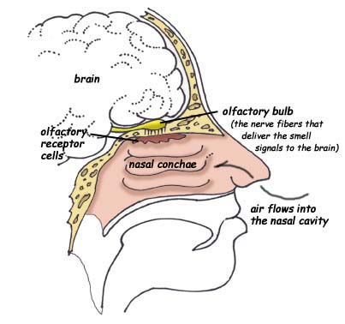
Exercise 2: Chemical Olfaction
Diagram of the human olfactory system. Amsel, Sheri. “Special Senses.” Smell. Exploring Nature Educational Resource. © 2005 - 2012. February 23, 2012. http://exploringnature.org/db/detail.php?dbID=25&detID=49

Slide 112
Exercise 2: Chemical Olfaction
The Basics of Vertebrate Olfaction:
Volatile substances (substances that easily evaporate) release molecules, known as odorants, into the air. The amount of odorants released by volatile substances is affected by temperature and humidity, with greater numbers of odorant molecules being released at greater temperatures.
When an air-breathing vertebrate inhales, odorant molecules are drawn into the nostrils, where they encounter the olfactory epithelium. Mucus, composed of water and proteins, within the nasal cavity also helps dissolve these molecules, forming a solution of mucus and odorant molecules.

Slide 113
Exercise 2: Chemical Olfaction
The Basics of Vertebrate Olfaction (continued):
The odorant molecules then bind to receptors on the cilia, or hairlike structures on olfactory neurons. Two major hypotheses regarding the binding of odorant molecules to receptors propose that molecules bind to receptors base on either the molecule's shape, or perhaps the infrared vibrational frequency of the molecule, with different receptors being specialized for particular molecular shapes or vibrational frequencies. There are approximately 400 different types of scent receptors in humans, each of which are stimulated by different types of molecules.
Binding of an odorant molecule to a scent receptor on a cilium causes the receptor to transmit this information to the olfactory bulbs at the front of the brain. The olfactory bulbs then transmit this information to other regions of the brain for further processing and interpretation.

Slide 114
Exercise 2: Chemical Olfaction
NOTE: Different "scents" are not always (or even usually) composed of just one type of molecule.
Different substances often release more than one type of volatile odorant molecules in varying concentrations.
Therefore, animals can detect many more different "scents" than they have types of olfactory receptors, based on which kinds and relative numbers of olfactory receptors that are stimulated by binding with odorant molecules.

Slide 115
Fun Facts About Olfaction
Snakes and lizards also use their tongues as olfactory organs.
When a snake or lizard flicks its tongue in and out, it is actually using its tongue to pick up odorant molecules, which are transferred to the Jacobson's organ in the roof of the mouth.
The forked tongues of all snakes and many lizards help these reptiles determine the direction of prey or predators.
Many other animals also have a Jacobson's organ, but it is not well-developed or used in certain animal groups.
Some mammals in which the organ is still fairly functional (such as cats, horses, buffalo, giraffes, goats, and llamas) will often open their mouths when smelling the air (known as the flehmen response), in order to also bring odorant molecules to their Jacobson's organ to assist in detection of various scents.

Slide 116
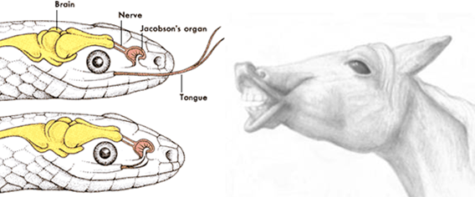
Fun Facts About Olfaction
Left: Illustration of the Jacobson's (vomeronasal) organ in snakes. Right: Flehmen response in a horse.

Slide 117
Fun Facts About Olfaction
Fish have openings on their snouts called nares (which is also a term used for other vertebrate nostrils), which connect the rest of their olfactory system to the external environment, and allow them to detect chemicals in the water.
However, these nares do not connect with the mouth or pharynx (throat) as nostrils do in vertebrates, and these openings are not involved in breathing in fish.
Insects and other invertebrates typically have large concentrations of olfactory receptors on their antennae (if present), but may also have olfactory receptors in other locations, such as on their mouthparts, and even on their reproductive organs!

Slide 118
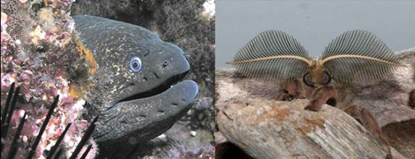
Fun Facts About Olfaction
Left: California moray eel showing conspicuous nares (credit: Clark Anderson/AquaImages). Right: Male Polyphemus moth showing off his antennae, loaded with olfactory receptors (credit: Megan McCarty).

Slide 119
Exercise 2: Chemical Olfaction
Click the name of an exercise below to jump to that exercise.
Exercise 2.1a: Coarse Level Discrimination (Grades K-12)
Exercise 2.1b: Fine Level Discrimination (Grades K-12)
Exercise 2.2: Find That Flower I (Grades K-12)

Slide 120
Exercise 2.1a: Coarse Level Discrimination
Locate the box labeled "Chemical Olfaction".
Take out the 6 jars with blue stickers (numbered B1-B6), and set them upright on a table. Do not open the jars.
NOTE TO TEACHERS: This exercise can be completed in one of two ways, as outlined below.
Method 1:
On a piece of paper, make a list, numbered B1-B6.
Your teacher will take the lid off of one jar at a time, and pass each jar around the room, allowing each student to smell the odor. Do not remove the cardboard cover and/or cotton ball in the jar, and do not to share your thoughts on the source of the smell with your classmates!
Note the number on the jar, and on your list, write down one or more guesses at the source of the odor in the jar beside the number corresponding to the number on the jar.

Slide 121
Exercise 2.1a: Coarse Level Discrimination
Method 2:
Six different stations should be set up at different points in the room, with a different "blue" jar, at each station.
On a piece of paper, make a list, numbered B1-B6.
In an orderly fashion, visit each of the stations, and remove the lid from the jar at the station. Smell the odor inside the jar. Do not remove the cardboard cover and/or cotton ball in the jar, and do not to share your thoughts on the source of the smell with your classmates!
Note the number on the jar, and on your list, write down a guess at the source of the odor in the jar beside the number corresponding to the number on the jar.

Slide 122
Exercise 2.1a: Coarse Level Discrimination
After smelling the six odors in the blue jars and recording ideas for the sources of the odors (using either Method 1 or Method 2 above), your teacher will make a list of suggested possible sources for each of the six odors (B1 to B6) on the board.
At this point, you may be given the opportunity to smell each jar again.
For each jar, your teacher will determine the number of students (by show of hands) that chose each of the suggested odor sources for each jar.
Now you should construct a bar graph for each jar, B1 through B6, indicating the number of students who chose each of the suggested sources.

Slide 123
Exercise 2.1a: Coarse Level Discrimination
Bar graphs are useful tools for us to compare sets of information within a certain category.
Before you construct your graph, your teacher will provide you with some examples of bar graphs and explain the different parts of the graphs.
You will then decide what your horizontal and vertical axes will represent, as well as the scale you will use.
Your scale will depend on the range of your data. The range is the difference between the smallest number and largest number in your data.
It will be very important for you to be as neat and accurate as possible so your graph will be easy for someone else to read.

Slide 124
Exercise 2.1a: Coarse Level Discrimination
Be sure to label both axes so the reader knows what they represent.
You should also include a title for your graph.
Your title should be a very brief explanation of what your graph describes.
A graph is a visual explanation of a set of data, so its purpose needs to be clear to anyone looking at the graph.
Your teacher will now provide you with another list of sources of the odors.
However, this time, the list will only be a list of the actual sources of the odors for all of the blue jars.
Repeat the exercise above, and for each jar, choose one of the possible options for the source of the odor.

Slide 125
Exercise 2.1a: Coarse Level Discrimination
Now make a second graph indicating the possible sources of the odors described in the list, and the number of students selecting those sources correctly.
Compare the information in your graphs.
How are they similar?
How are they different?
What do you think influenced any similarities or differences?
As a class, discuss the following questions.
Did you do better choosing among the given list of odors or choosing an odor without the list of possible odor sources?
In what way did having a list of potential odor sources influence your choices?

Slide 126
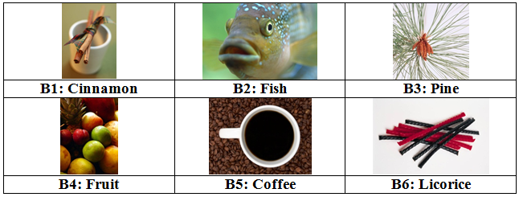
Exercise 2.1a: Coarse Level Discrimination
Answers for Exercise 2.1a: Coarse Level Discrimination

Slide 127
Exercise 2.1b: Fine Level Discrimination
The procedure for this exercise is identical to the procedure for the previous exercise, except using the "red" jars (numbered R1-R6) in place of the blue jars.
These jars, however, have much more similar odors than the blue jars, with the odor in each jar having a fruit scent.
How many of the various scents can you correctly identify?
After smelling the six odors in the red jars and recording ideas for the sources of the odors, your teacher will make a list of suggested types of fruit for each of the six jars (R1 to R6) on the board.
For each jar, your teacher will determine the number of students (by show of hands) that chose each of the suggested odor sources for each jar.
Now construct a bar graph for each jar indicating the number of students who chose each of the suggested sources.

Slide 128
Exercise 2.1b: Fine Level Discrimination
Your teacher will now provide you with another list of fruits representing the scents in the jars.
However, this time, the list will only be a list of the actual sources of the odors for all of the red jars.
Repeat the exercise, and choose one of the possible fruit scents for each jar.
Now make a second graph indicating the possible fruit scent described in the list, and the number of students selecting those sources correctly.
Compare the information in your graphs, and think about the following questions:
How are they similar? How are they different? What do you think influenced any similarities or differences? Which graph indicates more success in choosing the correct fruits? What do you think influenced the more successful identifications?

Slide 129
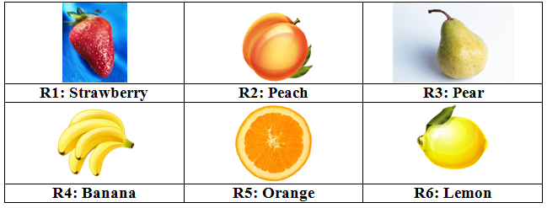
Exercise 2.1b: Fine Level Discrimination
Answers for Exercise 2.1b: Fine Level Discrimination

Slide 130
Exercise 2.2: Find That Flower I
Insects and flowers have a close tie to one another.
Because flowers are stationary, many rely on insects for pollination.
In insect pollination, insects carry pollen from the anther (male part) of one plant to the carpel (female part) of another, permitting the plants to produce fertile seeds.
In return, plants often produce nectar to attract and feed the insects that conduct this delivery function for them.
Insects have sensory organs to locate flowers, they have wings to get them to flowers that might be widely spaced, and they remember nectar rewards.
Thus a given insect tends to focus on the same species of flower in a foraging bout, and this increases the chance that flowers will successfully produce seed sets.

Slide 131
Exercise 2.2: Find That Flower I
It is actually very important to the plants that an insect visits only flowers of the same species when it is foraging from one plant to another, or all the nectar and pollen the individual plants have produced would go to waste.
Thus different insects are attracted to the characteristic odors particular plant types produce.
This exercise is a class activity that explores the flower selection process (and the relative importance of olfactory senses) of three insect types: a bee, a fly, and a butterfly.

Slide 132
Exercise 2.2: Find That Flower I
Instructions:
In the "Chemical Olfaction" box, find the three green jars (labeled "bee," "fly," and "butterfly"), a blindfold and a set of deely-boppers (a headband with wiggly antennae).
The class should line up in two columns of individuals facing one another with sufficient space between the columns for an insect (member of the class) to walk through.
Find a volunteer to serve as a foraging bee. The bee should place the deely-boppers on her/his head, as well as the blindfold.
The teacher should find the "bee" jar, and identify a student in one of the columns that will serve as the target flower. Be careful not to reveal where this target flower is to the blindfolded individual.

Slide 133
Exercise 2.2: Find That Flower I
Instructions:
The "target flower" student should open the "bee" jar, and hold the jar out in front of his or her body at neck height.
The blindfolded "bee" should now walk down the space between the two columns of students, and attempt to find the target flower by the scent it emits.
Optionally, the above procedure can be repeated, with different students taking turns acting as the bee and target flower.
The "bee" jar should then be closed, and returned to the "Chemical Olfaction" box.
Repeat the above steps, first with the fly and then with the butterfly roles and scents.

Slide 134
Exercise 2.2: Find That Flower I
Instructions:
After conducting each of these simulations, have each of the students that played insect roles share with the class their relative experiences in their attempts at finding the target flower.
After the class discussion, then read about the preferences of these insect groups on the next slide.

Slide 135
Exercise 2.2: Find That Flower I
Flowers have evolved fragrances or scents that attract animals that vary in their sensitivity to them.
Bees are attracted to what humans would call sweet or spicy scents. Because we can detect these scents and they register as pleasant to us, many perfumes are similar in scent to the flowers bees are attracted to.
Flies unlike bees are attracted to odors that are not very pleasant to humans. As they lay their eggs (oviposit) on rotting flesh and dung, plants that emit similar odors attract them.
Butterflies and birds are not very olfactory. They are much more visual in behavior. Thus, your butterfly did not do very well in locating the target flower. That is, unless this particular student had an unusually acute sensitivity to the odor emitted by a cotton ball!

Slide 136
Exercise 3: Vision
Touch and smell provide important information to animals about their environments and the activities of other animals in them.
However, these senses are limited to simple messages.
In the more complex animals, two vibrational senses, sight and hearing, are utilized prominently in communication among individuals and both in detecting prey and avoiding predators.
Most animals are sensitive to light in one manner or another, and vision involves the perception and processing of stimuli in the form of light.
In this series of exercises, you will explore the function of vision in foraging, the avoidance of predation, and in social communication.

Slide 137
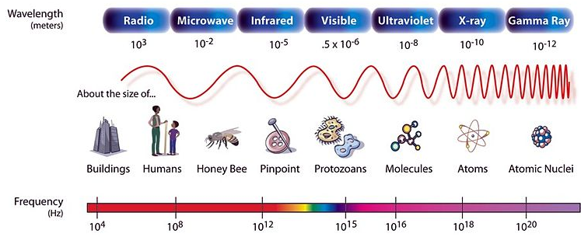
Exercise 3: Vision
Visible light is actually a narrow band of electromagnetic radiation of very short wavelengths.
Electromagnetic radiation is a form of energy that is the result of interactions between electric and magnetic fields generated by the motion of charged particles (like electrons).
Electromagnetic radiation includes different types of waves, such as radio waves, microwave energy, X-rays, visible and ultraviolet light, as well as others.

Slide 138
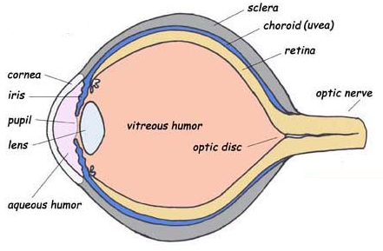
The Basics of Vision in Humans
Light reflected from objects passes through the cornea, a clear layer of the sclera, which is the tough outer layer of the eye.
Light that enters the cornea is refracted (bent), and then passes through the aqueous humor, a watery liquid, before finally passing through the pupil, which is a hole that allows light to enter the interior of the eye. The iris, or colored part of the eye, is composed of mostly smooth muscle that expands and contracts to adjust the amount of light entering the eye.

Slide 139
The Basics of Vision in Humans (continued)
After entering the eye at the pupil, light then passes through the lens, which helps to further focus the light passing into the eye, directing it through the vitreous humor, and onto the retina, or the inner lining of the eye that is involved with sensing light.
The uvea, which contains blood vessels that supply nutrients to and conduct gas exchange within the tissues of the eye, is very dark in color, thus reducing further reflection of light within the eye, much as the black interior of a camera. This helps improve the contrast of images projected onto the retina.

Slide 140
The Basics of Vision in Humans (continued)
Due to the nature of the refraction of light through the cornea and lens, the image that is projected onto the retina is actually projected upside down.
The retina contains special types of cells that are involved in the detection and processing of visual stimuli. There are two varieties of these cells, each of which is named based on their shape.

Slide 141
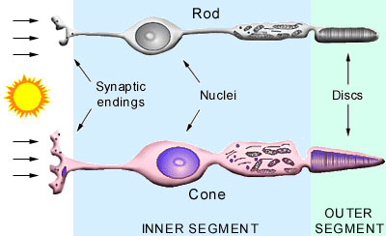
The Basics of Vision in Humans (continued)
Rods are primarily involved in vision in low-light conditions, and distinguishing the basic shapes of objects.
Cones are primarily devoted to color vision and detail.
In humans & closely related primates, & most marsupials, cones come in three different types: red, green, or blue.
Each type of cones can detect a range of wavelengths, but are most sensitive to the wavelengths of light corresponding to those particular colors.

Slide 142
The Basics of Vision in Humans (continued)
You might be wondering how or why we see many colors, when we only have three types of cones.
This is because even though each of the three types of cones (red, green, and blue) is most sensitive to wavelengths of light of their respective colors, they can still be stimulated by other wavelengths.
Our brains process the combinations of different levels of stimulation to each of these types of cones as different colors.

Slide 143
The Basics of Vision in Humans (continued)
The outer segments of both rods and cones contain chemicals that are photosensitive (react to light).
In rods, the primary photosensitive chemical is known as rhodopsin, while the cones' photosensitive chemicals are color pigments.
Incidentally, rhodopsin, which is important in detecting light in dim conditions (though not involved with color vision), is derived from vitamin A.
Foods rich in vitamin A include carrots, sweet potatoes, dark leafy greens, apricots, and cantaloupe.
Getting enough vitamin A is important for good vision, as vitamin A deficiency can lead to night blindness.
This is one of many good reasons to eat lots of fruits and veggies!

Slide 144
The Basics of Vision in Humans (continued)
When light strikes rods and cones, the photosensitive chemicals in these cells undergo reactions that generate electrical impulses, which are eventually transmitted to the optic nerve.
These electrical impulses are passed along the optic nerve to the brain, where they are interpreted in the visual cortex, which nearly instantaneously inverts the inverted image from the retina, allowing us to perceive the actual upright object that we are observing.

Slide 145
Fun Facts About Vision
Color vision varies substantially in the animal kingdom!
Most mammals, with the exception of humans and closely related primates, have only two types of cone cells, and are thus color-blind to some degree.
In New World monkeys, most males only have two types of cones, while many females have three types of cones. Exceptions include owl monkeys, which only have a single type of cone, and howler monkeys, which all have three types of cones.
Pinnipeds (seals, walruses, and their relatives) and cetaceans (marine mammals including whales and dolphins) only have one type of cone.

Slide 146
Fun Facts About Vision
Fish and birds have a fourth type of cone that can detect other wavelengths of light, sometimes including ultraviolet light.
Many insects, including honeybees, have three types of cone cells, for green, blue, and ultraviolet light.
The point at which the optic nerve connects to the retina, known as the optic disc, has no rods or cones.
Light that strikes this region is not detected, leading to this region being known as the eye's "blind spot".
However, we have stereoscopic vision, or in other words, the visual information reaching the brain comes from two "channels" (the left and right eyes).
The brain "fills in" missing information from the blind spot of each eye with information obtained from the other eye!

Slide 147
Exercise 3: Vision
Click on the name of an exercise below to jump to that particular exercise.
Exercise 3.1: Find That Flower II
Exercise 3.2: Slap Snack Alarm/Mimic
Exercise 3.3: Jumping Spider Dances

Slide 148
Exercise 3.1: Find that Flower II (Grades K-12)
In the exercises on chemical olfaction, you learned that some insects (e.g., bees and flies) locate flowers by the particular odors they give off to advertise their available nectar supplies.
Bees also use the visual sense to locate nectar sources, though they are not as restricted to vision as are the butterflies.
Flower parts and their colors have evolved to attract particular insects.
For instance, there are few green flowers, because flowers need to present a target to potential pollinators, and green flowers would be more difficult to locate amongst a plant's leaves.

Slide 149
Exercise 3.1: Find that Flower II (Grades K-12)
Different insect species are sensitive to different color patterns.
Many insects (such as bees) can see into the ultraviolet (UV) spectrum.
The UV spectrum has a much smaller wavelength than visible light, and is not visible to humans and most other vertebrates (birds are an exception).
On the following slide, you will see some comparisons of how flowers look to us and how those same flowers might appear to bees (and other animals that can see the UV spectrum).

Slide 150
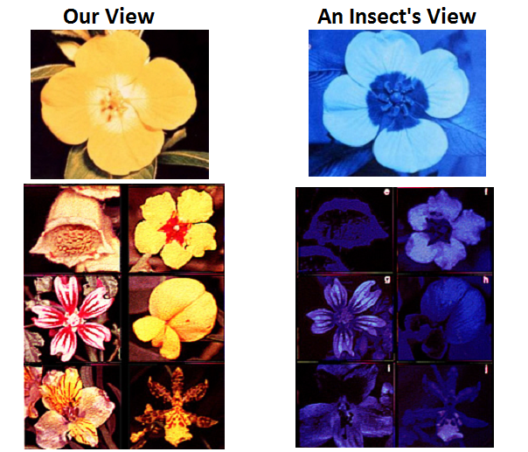
Exercise 3.1: Find that Flower II (Grades K-12)
You may notice a similarity in the "Insect View" images to what you might see if the flowers were placed under a "black light".
This is because a black light, which emits ultraviolet light (invisible to humans, though they also emit a small amount of visible violet light), can cause some objects to fluoresce, or emit light of a longer wavelength of light that is visible to humans.

Slide 151
Exercise 3.1: Find that Flower II (Grades K-12)
The view of objects under a black light can reveal patterns that we would not otherwise be able to see, but that would be visible to bees and other insect pollinators.
Many flowers that look otherwise uniform in color to us actually have striking patterns, often in a "bulls-eye" design to attract insect pollinators to the "target" area of the flower, where pollen can be transferred, and nectar rewards can be found.

Slide 152
Exercise 3.1: Find that Flower II (Grades K-12)
Find the "Vision" box, and take out the two flowers inside.
Four volunteers from the class should be selected.
Two of these volunteers should be designated as flower holders. Each flower holder should be given one of the included flowers, which they should hold by the stem, and wave gently (since flowers wave in the breeze!).
The tube behind each flower should have some "nectar" in it (represented by a few red pompoms). If these are missing, add a few from the included packet of replacement "nectar".
The other two student volunteers will serve as insects. Each will place a coffee stirrer straw in his or her mouth and should clasp their hands behind their backs.
Assign one insect to a particular flower and the other to the remaining flower.

Slide 153
Exercise 3.1: Find that Flower II (Grades K-12)
Each "flower" and "insect" pair should face one another such that the flower tube is visible to the rest of the class.
At the count of three, each insect should attempt to get its proboscis (straw) down into the nectar tube of its flower as it waves in the breeze.
The object is to drag some nectar (a pompom) up the tube towards the flower head.
There is no need to take the ball out of the tube; simply bring it up to the flower head.
Repeat with several other insect volunteers.
While engaging in the exercise of the insects dragging nectar toward the flower head, your teacher will make a table on the board indicating which flower was the “winner” in each attempt.

Slide 154
Exercise 3.1: Find that Flower II (Grades K-12)
Does the data indicate one flower was more often associated with the winner?
Why might that be?
Discuss your reasoning with your teacher and other students.
After a bit of discussion, the class should examine the two flowers to see if they note any differences between them.
Go to the next slide for the answer!

Slide 155
Exercise 3.1: Find that Flower II (Grades K-12)
One of the flowers has a funnel that guides the insect's proboscis (straw) to the nectar source.
Most flowers have not only petals shaped in a funnel but also nectar guides, lines or color patterns that radiate out from the source of the nectar reward.
These lines are like the painted lines on a runway guiding a plane down to an airport.
The anthers will be located above the funnel or below the legs of the insect standing on the landing platform such that pollen will stick to the legs for transport to other flowers of the same species.
Go to the next slide for images illustrating nectar guides on flowers, as well as the pollen transfer sequence in insect pollination.

Slide 156
Exercise 3.1: Find that Flower II (Grades K-12)

Slide 157
Exercise 3.2: Slap Snack Alarm/Mimic
Unless an animal is at the top of its food chain, it faces the problem of predation.
Because of their small size, insects are a major prey source to many other organisms, including mammals and birds.
Insects have developed two prominent mechanisms of avoiding predation:
Many plant feeders incorporate noxious chemicals plants produce to avoid being eaten into their own tissues.
This makes these insects taste bad, and many are even poisonous to eat.
Other insects have developed venoms which are toxins that can be injected into a predator by way of specialized hairs, stingers, or mouthparts.
If you have ever been stung by a wasp, you know firsthand how effective insect stings can be at repelling predators!

Slide 158
Exercise 3.2: Slap Snack Alarm/Mimic

Slide 159
Exercise 3.2: Slap Snack Alarm/Mimic
Just as red, yellow, and orange warning signs attract our attention when we are driving, these colors can also attract predators’ attention.
A young predator may initially be attracted to and eat one or two brightly colored insects, but quickly learns to associate these colors with things that are bad to eat.
In the following exercises, you will play the role of predators making decisions about what prey to eat.
However, you will also be competing with your classmates, simulating the predator problem of limited food resources.
Click the name of an exercise below to jump to that exercise.
Exercise 3.2a: Slap Snack Alarm (Grades K-12)
Exercise 3.2b: Slap Snack Mimic (Grades 3-12)

Slide 160
Exercise 3.2a: Slap Snack Alarm (Grades K-12)
In this exercise, you will pretend that you are hungry birds looking for something to eat.
You will play this game in small groups, which simulates the fact that many birds often search an area for food together.
As you encounter a potential prey item, you need to very quickly decide whether to attack it or not.
If you act too quickly and attack every prey item, you might end up eating a prey item that could make you sick, or that could injure you.
However, if you are too slow in your response, an edible prey may escape, or another bird might get it first.

Slide 161
Exercise 3.2a: Slap Snack Alarm (Grades K-12)
Divide into groups of about 4 students.
Each group will be given an "Alarm" deck of cards.
One student should serve as the dealer, and the others as birds.
The dealer will turn one card over and place it in the center of the group of birds. The first person to slap that card with his or her hand gets the prey item, and moves it to his/her pile.
If no bird attacks a given card, the dealer moves it to a "not eaten" discard pile next to the original deck.
Continue the foraging bout by offering all cards in the deck one at a time for potential predation.

Slide 162
Exercise 3.2a: Slap Snack Alarm (Grades K-12)
At the end, check your cards against the following slides.
Remove one "nutritious" prey item card from your pile for every "poisonous" or "venomous" prey card in your pile, representing the consequences of eating harmful prey.
The number of cards each bird has left is their "food reward score" for the round.
Which member of your group was the best forager (had the highest food reward score)?
Also, the more "poisonous" and "venomous" prey item cards "not eaten", the better your group is at being "smart" predators.
This card game can be extended so that those with the highest food reward score from each of the original groups can then compete in another round to determine an overall winner.
Discuss the characteristics of the winning bird that allowed them to be a ‘smart’ predator.

Slide 163
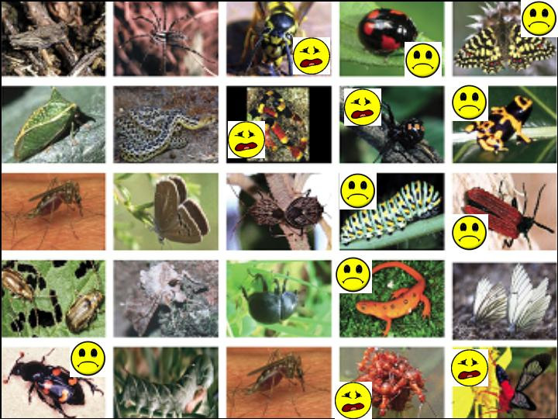
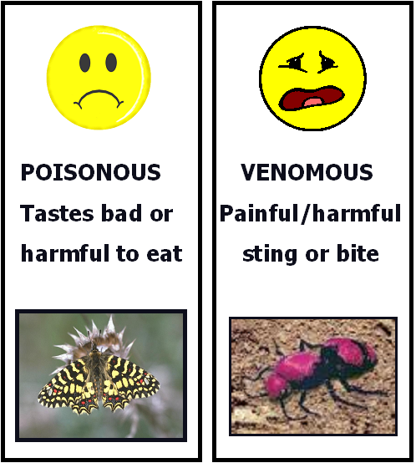
Exercise 3.2a: Slap Snack Alarm (Grades K-12)
Click HERE for an exercise on probability, and the advantage of good vision to predators.
Click HERE to go back to the exercise list for Exercise 3.2a.

Slide 164
The Advantage of Good Vision to Predators
Sometimes you will hear about how a certain trait will give an animal a better chance of survival.
What does that really mean?
Let’s pretend that you are a bird that can’t see very well, so that you must choose a card (prey) without being able to see whether it is a good-colored insect or a bad-colored insect.
If you randomly slap a card without seeing the color, are you more likely to get a good card or a bad card?
The likelihood that something will occur is also called probability.
It is also known as chance.

Slide 165
The Advantage of Good Vision to Predators

Slide 166
The Advantage of Good Vision to Predators
In the Alarm deck, there are 13 “nutritious” cards and 25 cards total. Use this to answer the following questions:
Q1. If you can’t see well and must choose your prey card at random, what is the probability that you will choose a good card?
CLICK FOR THE ANSWER!
The probability that a card chosen at random is a good card is equal to 13/25 = 0.52 = 52%.
Q2. Is the probability from Q1 better or worse than if you were to toss a coin?
CLICK FOR THE ANSWER!
The probability of choosing a good card at random from the Alarm deck is slightly better than the probability of correctly calling the toss of a coin.

Slide 167
The Advantage of Good Vision to Predators
Q3. Luckily, you can see very well. When you played the game, what percent of the cards that you chose did you get right? Was this better than your probability if you had to choose prey at random? How is having good vision a survival advantage for predators? Justify your answer.
CLICK FOR THE ANSWER!
Answers will vary, but after the introduction on aposematic coloration of chemically defended prey, most of you likely got a higher percentage of "good" cards than that expected by chance alone (if you had simply randomly slapped/"eaten" prey item cards). Good vision is an advantage for predators, because being able to correctly identify potential prey as either nutritious or harmful directly influences a predator's chance for survival.

Slide 168
The Advantage of Good Vision to Predators
Q4. Explain how competition with other predators when you played the game may have affected the ratio of your success.
CLICK FOR THE ANSWER!
Competition likely reduced your ratio of success.
The pressure of competition might cause predators to quickly accept prey items without considering whether the prey might be chemically defended as carefully as they would have if other predators were not actively foraging for the same resources at the same time.
Also consider the fact that in addition to the ratio of success, a predator’s "food reward score" is also important.
Competition also decreases the average number of nutritious prey available per predator, also resulting in a smaller possible food reward score on average, for each predator.
Click HERE to go to Exercise 3.2b on mimicry for Grades 3-12.

Slide 169
Exercise 3.2b: Slap Snack Mimic (Grades 3-12)
Because many bad tasting and venomous insects escape predation due to their bright colors, many other species of insects "cheat" by producing similar bright color patterns.
This is called mimicry, in which a species lacking chemical defenses mimics a model species (that does have chemical defenses) that occurs in the same habitat.
The advantage to the mimic is that the predator may have previously experienced a capture attempt with the model species, and has learned to avoid insects with a similar appearance.
In this exercise, you will be foraging birds feeding in groups individuals that are competing for food.
You will be required to make a quick decision as to whether an insect is palatable (tasty) or not (chemical defenses present).

Slide 170
Exercise 3.2b: Slap Snack Mimic (Grades 3-12)
The object of this game is to receive the greatest food reward score.
You will receive +2 points for taking a prey that is neither a model nor a mimic.
You will get +5 points for taking a mimic.
However you will suffer (-10 points) for taking a model (chemically defended) prey item.
Divide into groups of 4 or 5 students sitting around a cleared desk.
Each group will be provided with a deck of cards (labeled "Mimic 1" or "Mimic 2" on the backs of the cards.
Examine the mimicry sheets on the next few slides.

Slide 171
Exercise 3.2b: Slap Snack Mimic (Grades 3-12)

Slide 172
Exercise 3.2b: Slap Snack Mimic (Grades 3-12)

Slide 173
Exercise 3.2b: Slap Snack Mimic (Grades 3-12)

Slide 174
Exercise 3.2b: Slap Snack Mimic (Grades 3-12)

Slide 175
Exercise 3.2b: Slap Snack Mimic (Grades 3-12)
The diagram above illustrates some characteristics that can be used to distinguish between various orders of insects, as well as how to distinguish spiders from insects. These may come in handy for some groups of models/mimics!

Slide 176
Exercise 3.2b: Slap Snack Mimic (Grades 3-12)
Assign one individual as a dealer. The others will be birds in the foraging group.
The dealer should construct a score sheet with the names of all birds on it, and a note to whether the "Mimic 1" or "Mimic 2" deck is used in the game.
The dealer will turn one card over and place it in the center of the group of birds. The first person to slap that card with his or her hand gets the prey item, and moves it to his/her pile.
If no bird attacks a given card, the dealer moves it to a "not eaten" discard pile next to the original deck.
After each prey is captured, the bird can check the point value of the captured prey by placing the included red cellophane sheet over the card, which will reveal the point value.
The dealer should then write this score down under that individual's name on the group's foraging score sheet.

Slide 177
Exercise 3.2b: Slap Snack Mimic (Grades 3-12)
Possible scores for a particular prey are +2, +5 and -10, where +2 is the reward for taking a prey that is not a mimic or a model, +5 is the reward for taking a mimic, and -10 is the penalty for taking a harmful or distasteful model prey.
The dealer should continue the foraging bout by offering all cards in the deck one at a time for potential predation.
At the end, the dealer will add up all of the scores.
The bird with the highest total score is the best predator in the group (has the highest fitness reward).
Repeat this game a few more times, and then switch decks with another group.
If you previously played the game with the "Mimic 1" deck, switch decks with another group that had the "Mimic 2" deck and vice versa.
Repeat the game a few times with the other deck, as well.

Slide 178
Exercise 3.2b: Slap Snack Mimic (Grades 3-12)
Have a class discussion concerning the differences in outcomes (the overall final scores) between the "Mimic 1" and "Mimic 2" decks.
Can you explain why such differences might have been observed?
Did you notice that finding nutritional prey items was easier or harder in one deck versus the other?
The difference in these two decks is meant to tell us something important about mimicry: that mimicry works better in one situation than another.
What exactly is the difference between these decks, and how does this apply to real world situations of hungry birds and their prey?
Sometimes games like this one add complexity by making the outcomes worth more or less points (aka different payoffs).

Slide 179
Exercise 3.2b: Slap Snack Mimic (Grades 3-12)
Think again about a coin toss game.
Imagine if you were going to toss a coin many times, but must first choose one of two different options:
Option 1: Heads will win you $2, if tails you lose $3
Option 2: Heads will win you $6, if tails you lose $4
Which game would probably result in the best payoff for you? You can figure this out by calculating the expected value.
This is the average outcome that you would expect over time, if you played the game a lot.
It is important to note that since chance is involved, this is only a predictor, and may not reflect your actual outcome.

Slide 180
Exercise 3.2b: Slap Snack Mimic (Grades 3-12)

Slide 181
Exercise 3.2b: Slap Snack Mimic (Grades 3-12)

Slide 182
Exercise 3.2b: Slap Snack Mimic (Grades 3-12)
First let’s look at the cards in Mimic Deck 1:
Copy this table, and use it to answer the questions on the following slides.
Card Type | Card Value | # of Cards
Nutritious (non-mimic) | + 2 | 15
Mimic (nutritious) | + 5 | 4
Model (poisonous/venomous) | - 10 | 6

Slide 183
Exercise 3.2b: Slap Snack Mimic (Grades 3-12)
Q1. If you selected a card at random from Mimic Deck 1, what is the probability that the card is a mimic card?
CLICK FOR THE ANSWER!
There are 4 mimic cards in Mimic Deck 1, out of a total of 25 cards. Therefore, the probability that a card selected at random would be a mimic would be P(mimic) = 4/25 = 0.16
Q2. If you selected a card at random from Mimic Deck 1, what is the probability that the card is a model (poisonous or venomous) card?
CLICK FOR THE ANSWER!
There are 6 model cards in Mimic Deck 1, out of a total of 25 cards. Therefore, the probability that a card selected at random would be a model would be P(model) = 6/25 = 0.24

Slide 184
Exercise 3.2b: Slap Snack Mimic (Grades 3-12)
Q3. If you selected a card at random from Mimic Deck 1, what is the probability that the card is a nutritious non-mimic card?
CLICK FOR THE ANSWER!
There are 15 non-mimic cards in Mimic Deck 1, out of a total of 25 cards. Therefore, the probability that a random card would be a non-mimic would be P(non-mimic) = 15/25 = 0.60
Q4. Using the values & probabilities you calculated in Q1-Q3, what is the expected value for a card drawn from Mimic Deck 1?
CLICK FOR THE ANSWER!
The expected value of a card would thus be calculated as follows:
Expected Value (Mimic 1) = (2)(0.6) + (5)(0.16) + (-10)(0.24)
Expected Value (Mimic 1) = 1.2 + 0.8 - 2.4
Expected Value (Mimic 1) = -0.4

Slide 185
Exercise 3.2b: Slap Snack Mimic (Grades 3-12)
Now let’s look at the cards in Mimic Deck 2:
Copy this table, and use it to answer the questions on the following slides.
Card Type | Card Value | # of Cards
Nutritious (non-mimic) | + 2 | 15
Mimic (nutritious) | + 5 | 7
Model (poisonous/venomous) | - 10 | 3

Slide 186
Exercise 3.2b: Slap Snack Mimic (Grades 3-12)
Q5. If you selected a card at random from Mimic Deck 2, what is the probability that the card is a mimic card?
CLICK FOR THE ANSWER!
There are 7 mimic cards in Mimic Deck 1, out of a total of 25 cards. Therefore, the probability that a card selected at random would be a mimic would be P(mimic) = 7/25 = 0.28
Q6. If you selected a card at random from Mimic Deck 2, what is the probability that the card is a model (poisonous or venomous) card?
CLICK FOR THE ANSWER!
There are 3 model cards in Mimic Deck 1, out of a total of 25 cards. Therefore, the probability that a card selected at random would be a model would be P(model) = 3/25 = 0.12

Slide 187
Exercise 3.2b: Slap Snack Mimic (Grades 3-12)
Q7. If you selected a card at random from Mimic Deck 2, what is the probability that the card is a nutritious non-mimic card?
CLICK FOR THE ANSWER!
There are 15 non-mimic cards in Mimic Deck 1, out of a total of 25 cards. Therefore, the probability that a random card would be a non-mimic would be P(non-mimic) = 15/25 = 0.60
Q8. Using the values & probabilities you calculated in Q5-Q7, what is the expected value for a card drawn from Mimic Deck 2?
CLICK FOR THE ANSWER!
The expected value of a card would thus be calculated as follows:
Expected Value (Mimic 2) = (2)(0.6) + (5)(0.28) + (-10)(0.12)
Expected Value (Mimic 2) = 1.2 + 1.4 - 2.4
Expected Value (Mimic 2) = 0.2

Slide 188
Exercise 3.2b: Slap Snack Mimic (Grades 3-12)
Q9. Compare your answers from Mimic Decks 1 and 2. In what ways are Decks 1 and 2 quantitatively different? Which deck is “easier” on predators? Therefore, under what conditions does mimicry work best for prey? Justify your answer.
CLICK FOR THE ANSWER!
In both decks, the relative frequencies of nutritious, non-mimic prey items are the same. However, in Deck 1, the relative frequency of models is higher than that in Deck 2, and the relative frequency of mimics is lower than that of Deck 2.
In Deck 1, model organisms occur more frequently than mimics, and in Deck 2, mimics occur more frequently than models.
Go on to the next slide for additional information.

Slide 189
Exercise 3.2b: Slap Snack Mimic (Grades 3-12)
Also, you should notice that the expected value of a card in Deck 2 is higher than the expected value of a card in Deck 1.
In fact, the expected value of a card in Deck 2 is a positive value, while the expected value of a card in Deck 1 is negative.
A predator in the environment simulated by Deck 2 has a greater potential payoff to attack/eat any potential prey item at random, since it has a greater chance of encountering a tasteful mimic than a dangerous model, and can usually get away with taking prey even if they exhibit warning coloration.
In the environment simulated by Deck 1, predators are actually more likely to be injured or get sick (or worse!) if they attack/eat any potential prey item at random.
This should illustrate that mimicry usually works best for prey when dangerous model organisms are more abundant than the mimics themselves.

Slide 190
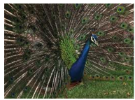
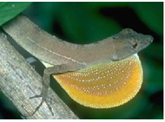
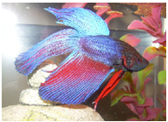
Exercise 3.3: Jumping Spider Dances
The two senses used in complex communication are vision and hearing.
Vision is particularly important in male courtship of females.
Species-specific color patterns and the complex movements used to display them help prevent wasted mating attempts between species.
Thus biologists often use courtship sequences to identify species relationships.
Females also choose among courting males of the same species on the basis of the quality of displays they offer.
Birds, lizards, and fish are perhaps best known for colorful courtship sequences.

Slide 191
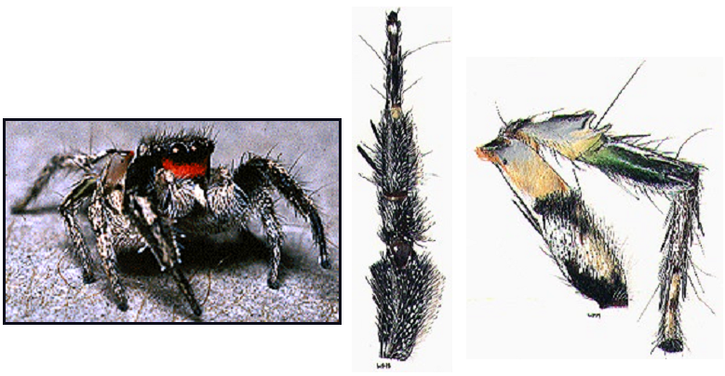
Exercise 3.3: Jumping Spider Dances
One would not expect spiders to have elaborate visual courtship sequences, as they generally have very poor vision.
Because of this, many spiders thus are not very colorful.
Major exceptions can be found in members of the Salticidae, or jumping spider family.
Males have bright color bands and patches on the body and legs that are displayed in elaborate dances.
Dr. Wayne Maddison and his students study relationships in the genus Habronattus, in part through male dances.
From left to right: Male Habronattus coecatus, showing red face band; illustration of leg-raising behavior in a H. coecatus courtship; banding on the third leg of a male H. coecatus.

Slide 192
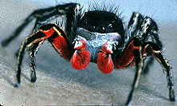
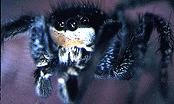
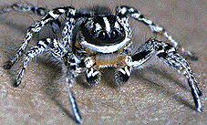
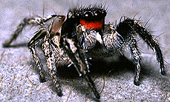
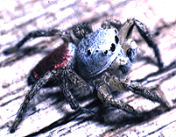
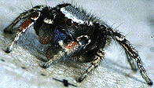
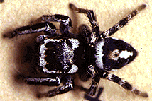
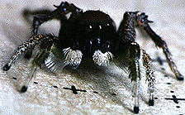
Exercise 3.3: Jumping Spider Dances
The following exercises use video clips of the courtship dances of several species of jumping spiders in the genus Habronnatus, illustrating differences in behavior among species.
H. americanus
H. tarsalis
H. tuberculatus
H. coecatus
H. jucundus
H. decorus
H. altanus
H. carolinensis
Credit for all spider images: Wayne Maddison
Click the name of an exercise to jump to that exercise:
Exercise 3.3a: Learn a Spider Dance (Grades K-1)
Exercise 3.3b: Develop an Ethogram (Grades 2-12)
Exercise 3.3c: Comparing Ethograms (Grades 8-12)

Slide 193
Exercise 3.3a: Learn a Spider Dance
Instructions for Teachers:
Locate the Unit 10 CD, & insert it into your computer's disc drive.
Find the folder named "Jumping Spider Dances," and open it.
This folder contains videos of the courtship dances of eight species of Habronattus.
Allow students to view each of the species' courtship dances several times, and choose (by vote) one whose dance they will learn.
Note that some of the dances are quite long, and thus are split into 3 clips in order from start to finish.
Play the clip again, now concentrating on the first action seen.
Pause the video and have a class discussion to describe this particular action, and allow students a chance to practice this first "dance move".

Slide 194
Exercise 3.3a: Learn a Spider Dance
Since we only have 4 limbs as opposed to the spider's eight, encourage students to pay attention to (and be creative with) the position of their arms and legs to reflect motions of different legs of the spider.
Repeat the previous step until each spider action has been described and duplicated by the students.
Have the students keep track of the order of actions performed, which motions were repeated, etc.
Once the sequence of actions for the spider's dance has been determined and duplicated, put all the moves together, and perform the dance together as a class.
You may even wish to give a performance of your spider dance to another class or the school!

Slide 195
Exercise 3.3b: Develop an Ethogram
What is an ethogram?
An ethogram is a quantitative description of the natural behavior of an animal species.
In the case of this exercise, however, you will limit your ethograms to the behavior (the courtship dances) of males directed towards females of various Habronattus species.
The goal of this exercise is to develop an ethogram, or step by step account of the courtship dance of one species of the jumping spider genus Habronattus.

Slide 196
Exercise 3.3b: Develop an Ethogram
Instructions for Teachers:
Locate the Unit 10 CD, and insert it into your computer's disc drive.
Find the folder named "Jumping Spider Dances," and open it. This folder contains videos of the courtship dances of eight species of Habronattus.
Allow students to view each of the species' courtship dances several times, and choose (by vote) one for which they will develop an ethogram.
Note that some of the dances are quite long, and thus are split into 3 clips in order from start to finish.

Slide 197
Exercise 3.3b: Develop an Ethogram
Play the clip of the chosen species again, instructing students to count the number of individual actions that occur in the dance, and to note this number.
After counting the number of actions that occur in the dance, have a class discussion to sort out any differences in the numbers of actions observed.
After an agreement on the number of actions has been reached, students should then make a list of numbers on a sheet of paper corresponding to the total number of acts they counted in the dance, with the teacher making a master list on the board.
Play the clip again, now concentrating on the first action seen. Each student should write a description of this action pattern beside #1 on their list of numbers.

Slide 198
Exercise 3.3b: Develop an Ethogram
The class should have a discussion of this action, and come up with a name that best describes it.
Use this name whenever you see this action again during the course of the dance. This will eliminate the need to write down the description each time.
Repeat these steps until all of the different actions have been defined and assigned a name.
Now view the dance again, observing the sequence of events from beginning to end, writing down the actions in the order that they occur.
You may need to repeat the clip a number of times to get all number slots filled.

Slide 199
Exercise 3.3b: Develop an Ethogram
Now count the frequency of each of the different actions.
How many times does each different action occur in the entire clip?
Make a table using tally marks for each time an action occurs.
A table provides you with an organized record of the collected data.
You can then use the data to make different types of graphs or use it as an easy-to-read reference for further study.
When you have completed tallying the actions, find the total of your tally marks for each action.
Construct a bar graph that compares the number of times each individual action occurs in the dance, with a bar for Action #1 and its name, Action #2 and its name, etc.

Slide 200
Exercise 3.3b: Develop an Ethogram
Which actions are most frequent?
Which actions are the least frequent?
Remember to include the important components of your bar graph: an appropriate scale for your data, the labels for the axes, and a descriptive title.
Use your collected data to construct another graph to detect patterns that may occur in the dance.
Your x-axis, or horizontal axis, will represent elapsed time. The y-axis, or vertical axis, will represent the different actions observed in the dance.
As the video clip is played, you will move from left to right on the x-axis, indicating changes in action with points corresponding to the action number/ name on the y-axis.

Slide 201
Exercise 3.3b: Develop an Ethogram
Do you see any patterns in the action sequence?
Are some of the actions more frequent than others?
Are some actions present in the beginning but not toward the end, or vice-versa?
Once your list is complete, you can perform the dance and describe the behavior in terms of an ethogram.
Are there repeated patterns, just as in the repetition of the chorus of a song?
Are some behavior patterns more frequent at the beginning of the sequence, and replaced by others later?

Slide 202
Exercise 3.3c: Comparing Ethograms
The goal of this exercise is to compare the dances exhibited by different species of jumping spiders in the genus Habronattus, and hypothesize relationships between species based on the actions they perform.
Divide into groups of 3-4 students each.
Each group will be assigned a different Habronattus species.
Following the same procedure as in the previous exercise, your group should complete an ethogram for your group's species, which you will share with other groups.

Slide 203
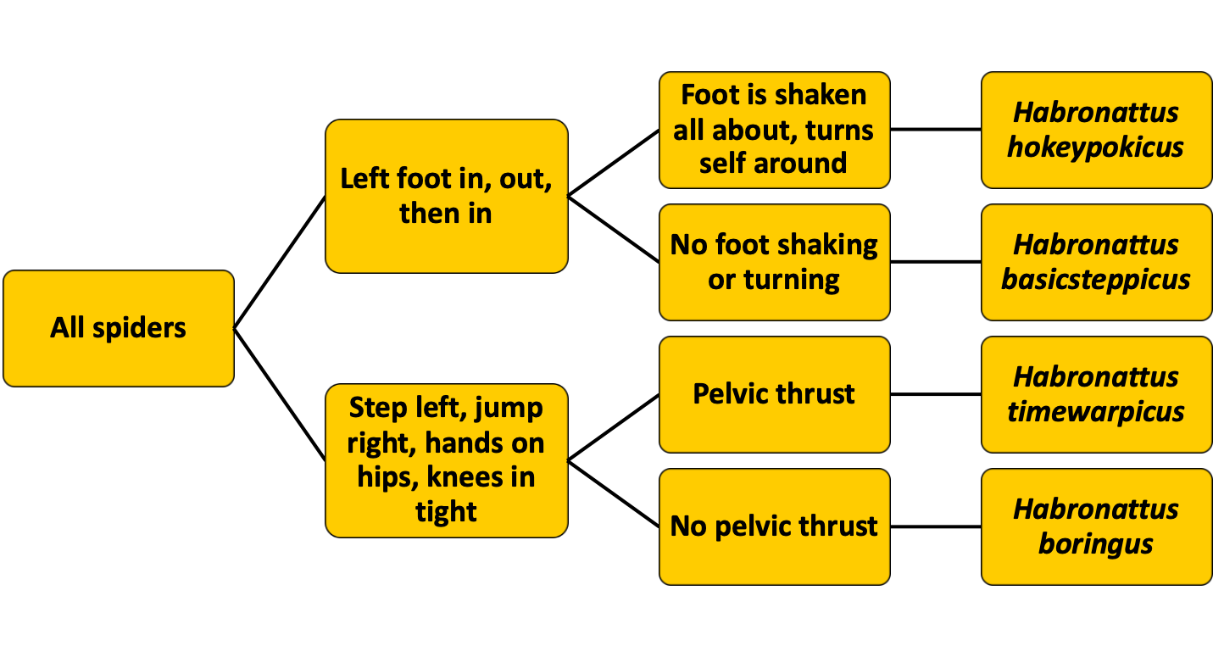
Exercise 3.3c: Comparing Ethograms
Below is an example of a branching diagram used to describe the differences and similarities in the dances of four very hypothetical species of Habronattus.

Slide 204
Exercise 3.3c: Comparing Ethograms
Compare the species relationship tree you have developed to that developed for these same species using molecular sequence data (found on the next slide), and answer the following questions:
Do species that are most closely related in their genetic make-up share more behavior patterns in common than more distantly related species?
Are there qualitative differences among the species (different behavior patterns), or are the differences merely quantitative (same behavior patterns but differences in relative frequencies of various actions among species)?

Slide 205
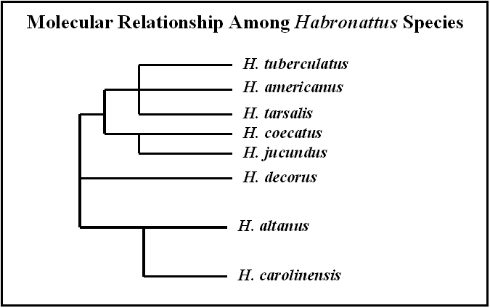
Exercise 3.3c: Comparing Ethograms

Slide 206
Exercise 3.3c: Comparing Ethograms

Slide 207
Exercise 4: Hearing is a Vibrational Sense
Many organisms have sensory cells that detect the movement of air or fluids.
Various insects have external "ears" in the form of a tympanum, or membrane that is sensitive to vibration.
Crickets and katydids, for example, have a tympanum on the tibia of each of their front legs, and grasshoppers possess a tympanum on each side on the first segment of their abdomens.
Terrestrial (land dwelling) vertebrates have sensory cells concentrated in two ears, one on either side of the head, that they use to hear sound.
Even fish & snakes (& a few lizards and other reptiles), which have no external ear or ear opening, have inner ears).

Slide 208
Exercise 4: Hearing is a Vibrational Sense
Additionally, fish also detect vibration in water through the use of their lateral line system, a series of receptor cells running along their sides, which can sometimes be seen as a faint line or groove running from the gill to the base of the tail.
In the vertebrate ear, sound waves hitting the ear cause movement of the fluid in a chamber housing sensory hair cells.
The movement of the fluid causes the fine hairs to bend, and receptors in each hair cell send this information to the brain for processing.
The sense of hearing is very important and well-developed in nocturnal animals, since it is difficult to see at night, and such animals communicate mainly by sound.

Slide 209
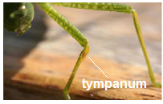
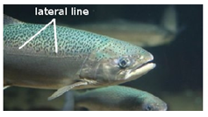
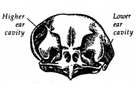
Exercise 4: Hearing is a Vibrational Sense
Top: A katydid, with the tympanum visible on the front tibia (image credit: Whitney Cranshaw, Colorado State University).
Center: The lateral line on a rainbow trout (image credit: Tomas Hellberg).
Bottom: The unusual asymmetrical arrangement of ear openings in owls helps them pinpoint sounds accurately in the dark.

Slide 210
Exercise 4: Hearing is a Vibrational Sense
Exercise 4.1 and Exercise 4.2 demonstrate how bats and spiders, respectively, use the vibrational sense to find food.
Exercises 4.3 and Exercise 4.4 examine calls that male frogs use to find mates, & provide further information on the science of sound, and how scientists visualize sound.
Click the name of an exercise below to jump to that exercise:
Exercise 4.1: Bat Echolocation (Grades K-12)
Exercise 4.2 The Vibration Sense of Spiders (Grades K-12)
Exercise 4.3: What Kind of Frog? (Grades 3-12)
Exercise 4.4: Frog Calls on Paper: Reading Spectrograms (Grades 6-12)
The Basics of Hearing in Mammals

Slide 211
Exercise 4.1: Bat Echolocation (Grades K-12)
Bats use high sound pitches that are at the upper limit of human hearing.
They actually produce ultrasonic calls that they send out into the night air in search of flying insects.
When these sound waves hit a flying object, the signal bounces back, just as a ball you have thrown at a wall comes back towards you.
Receptors in the bat’s ears are tuned to screen the ultrasonic playbacks to detect potential prey, and repeated calling permits the foraging bat to locate these prey.

Slide 212
Exercise 4.1: Bat Echolocation (Grades K-12)
Choose an individual who will be the bat in this exercise. This person should put on the included blindfold.
Five additional students should be selected as moths, the favored prey of most bats.
In a place free of furniture and other objects that our bat might trip on, the rest of the class should form a circle around the bat and moths.
The goal of this exercise is for the "bat" to locate all of the "moths" by echolocation.
The bat does this by calling out "BAT".
The moths must reply each time they hear the word bat by calling out "MOTH".
The bat should attempt, after hearing each reply, to move towards the call of the nearest moth.

Slide 213
Exercise 4.1: Bat Echolocation (Grades K-12)
The moth is captured if the bat touches it with his/her hand, at which point, the moth should exit the circle, and no longer respond to the bat's calls.
You might time this exercise to see if some students are better than others in using echolocation.
Be sure to place the blindfold back in the appropriate box at the end of this exercise.

Slide 214
Exercise 4.2 The Vibration Sense of Spiders
Most spiders (with the exception of the jumping spiders mentioned in Exercise 3) can see no more than a couple of centimeters distant (2.54 cm = 1 inch).
Therefore, the sense of "hearing" is the primary sense in most spiders.
When referring to spiders, however, the term "vibrational sense" is used rather than "hearing," which is a term whose use is typically restricted to use when referring to animals with actual ears.

Slide 215
Exercise 4.2 The Vibration Sense of Spiders
Spiders' do have "ears" in a sense, in that they do have organs that detect vibrations, similar to true ears.
However, a spider's vibration sensing organs are found primarily on their legs, but also in various other locations on the body.
These organs include lyriform organs, which are grooves, attached to nerve endings, in the spider's exoskeleton.
Trichobothria (singular = trichobothrium) are other vibratory sense organs in spiders.
Trichobothria are specialized hairs (distinct from the many other hairs on a spider's body) that fit into a cup-like socket. These specialized hairs are also sensitive to vibrational cues.

Slide 216
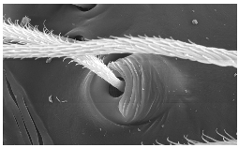
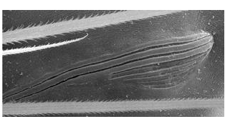
Exercise 4.2 The Vibration Sense of Spiders
To the right is a scanning electron micrograph of trichobothria on a spider's leg. Note the cup-like socket of one trichobothrium (image credit: Jeremy Miller).
This is a scanning electron micrograph of the lyriform organ in Amaurobius fenestralis (image credit: University of Bonn).

Slide 217
Exercise 4.2 The Vibration Sense of Spiders
As a spider sits on its web, an insect hitting the web causes the silk strands of the web to move
This in turn causes the spider’s feet and legs to move.
These vibrations also bend and vibrate the trichobothria, as well as change the shape of the exoskeleton around the openings of the lyriform organs.
The nerves associated with both the trichobothria and lyriform organs then send the vibratory information on for processing.
As in bats, a spider’s vibratory sense organs are tuned to particular vibration patterns.
Information on the type and size of insect hitting the web is obtained through this sense.

Slide 218
Exercise 4.2 The Vibration Sense of Spiders
In this exercise, you will explore the importance of this vibrational sense to spiders by getting the chance to play the role of a spider or of a spider's insect prey.
Divide into groups of 6 individuals.
One person in each group will be the spider and the other five students will play the role of insects.
Locate the "Vibration Sense of Spiders" box in this unit, which contains a wooden block with fishing lines attached, as well as a blindfold.
First unwind the fishing lines wrapped around the wooden block in the box.
The designated spider should hold the wood block in one hand.
Each insect should then take one of the monofilament lines and move away from the spider.

Slide 219
Exercise 4.2 The Vibration Sense of Spiders
The spider will then position his/her other hand on the top of the wood block such that one finger is resting on each of the five lines.
The spider should then be blindfolded, to reflect the poor visual capabilities of most spiders.
All moths should make sure that they are backed away from the spider until each of their lines is taut.
The teacher or a selected student should tap one of the moths, who will pluck his/her thread.
When the spider detects the pluck, it should pull on this line. Did the spider find the correct prey?
Switch roles, with different groups and individuals getting chances to serve as spider and moths.

Slide 220
Exercise 4.3: What Kind of Frog?
Animals use the vibrational sense to detect prey and to avoid predators.
Also, just as when people talk and others listen, animals also communicate through the production of sounds and the processing of these sounds.
Like birds, male frogs and toads sing to attract females to them.
It is important to both sexes that they locate (and attempt to mate with) only individuals of the same species, so each species has a unique song or call.
However, the calls of closely related species are more similar to one another than are other frog or toad calls.
In Tennessee, we have three major groups of frogs: the true frogs, the toads, and the tree frogs.

Slide 221
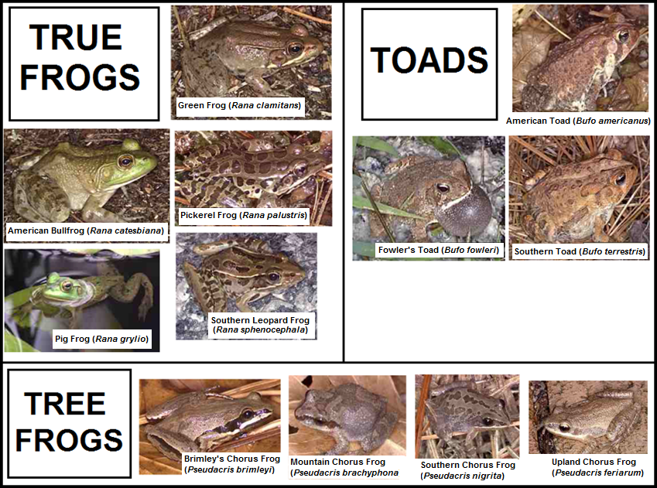
Exercise 4.3: What Kind of Frog?

Slide 222
Exercise 4.3: What Kind of Frog?
In this exercise, you will learn the differences in calls among the three major frog groups, and will then be asked to assign the calls that you hear to the correct group.
Take out a sheet paper and make a list of numbers from 1-11.
Your teacher should locate the Unit 10 CD, and place it in the disc drive of your classroom computer.
After opening the folder marked "Frog Calls," the teacher will play track 1 to introduce this exercise.
Listen closely to the guide as he describes the general characteristics of the calls of three major groups of frogs.
On track 2, you will hear several calls, numbered 1-11.
As you listen to each call, try to decide whether it was made by a true frog, tree frog, or a toad, and write these answers beside the appropriate number on your answer sheet.
On track 3, the guide will play the calls again, telling you what animal produced it.
You can also check your answers on the next slide.

Slide 223
Exercise 4.3: What Kind of Frog?
1. True Frog - Pig Frog (Rana grylio)
2. Toad - Southern Toad (Bufo terrestris)
3. Tree Frog - Upland Chorus Frog (Pseudacris feriarum)
4. Tree Frog - Southern Chorus Frog (Pseudacris nigrita)
5. True Frog - Southern Leopard Frog (Rana sphenocephala)
6. Toad - Fowler's Toad (Bufo fowleri)
7. True Frog - American Bullfrog (Rana catesbiana)
8, Tree Frog - Brimley's Chorus Frog (Pseudacris brimleyi)
9. Toad - American Toad (Bufo americanus)
10. True Frog - Pickerel Frog (Rana palustris)
11. Tree Frog - Mountain Chorus Frog (Pseudacris brachyphona)

Slide 224
Exercise 4.4: Frog Calls on Paper: Reading Spectrograms
It is easy enough to listen to songs made by various frog and toad species and detect differences among them.
Biologists, however, need to be able to measure the differences (quantify them) and determine the extent to which these calls vary.
We cannot simply take out a ruler and measure the differences in calls as we might do with the length of a leg or the height on an individual.
Nor can we take out a color chart and assign a color shade to it as we might do for eye or skin color.
One of the most basic techniques biologists use to analyze non-visual traits is to present the information graphically, a form that can be measured visually.

Slide 225
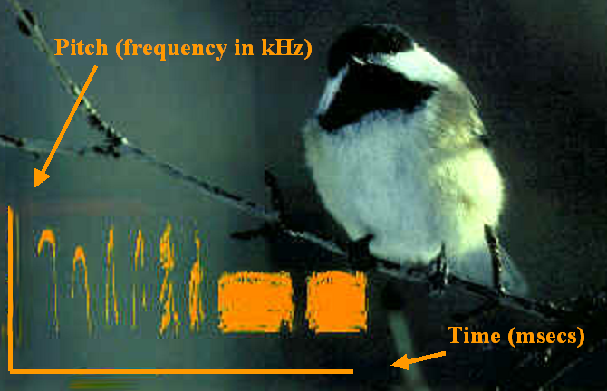
Exercise 4.4: Frog Calls on Paper: Reading Spectrograms
Sounds can be converted to sound spectrograms, in which they are laid out in two dimensions (time and frequency or pitch) as shown on the following graph of the chickadee's song.

Slide 226
Exercise 4.4: Frog Calls on Paper: Reading Spectrograms
In this exercise, you will learn how to read spectrograms.
Your challenge in the end will be to identify the spectrograms that belong to each of the mystery calls made by various true frog, tree frog, and toad species.
Find the CD for Unit 10 with the frog picture on it, and open track 4 for an introduction to this exercise.
Next, listen to track 5.
As you listen to this track, observe the spectrograms of the various sounds (on the next slides) on the track.
See if you can begin to form a mental connection between the graphical depictions of the sounds, and the sounds themselves.

Slide 227
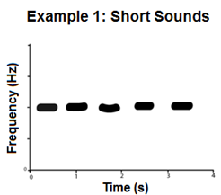
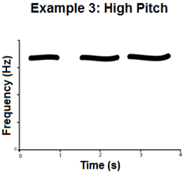
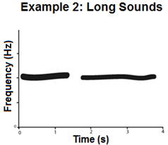
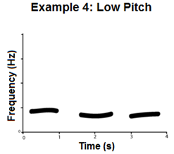
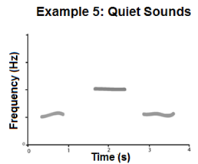
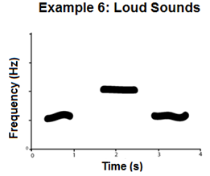
Exercise 4.4: Frog Calls on Paper: Reading Spectrograms

Slide 228
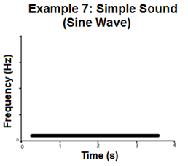
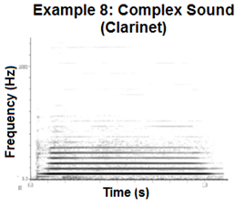
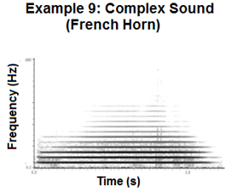
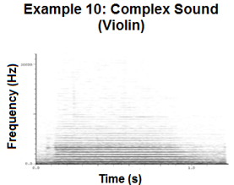
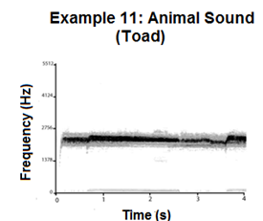
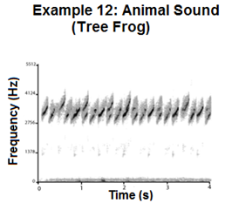
Exercise 4.4: Frog Calls on Paper: Reading Spectrograms

Slide 229
Exercise 4.4: Frog Calls on Paper: Reading Spectrograms
After you have listened to each of the various sounds, and examined their spectrograms, look back at the spectrograms, and fill in the following chart, verbally describing differences in the spectrograms of the pairs of sounds in the chart.
Comparison | Difference in Spectrograms
Short vs. Long Sounds (Examples 1&2)
High vs. Low Pitch (Examples 3&4)
Quiet vs. Loud Sounds (Examples 5&6)
Simple vs. Complex Sounds (Sine wave vs. Clarinet) (Examples 7&8)
French Horn vs. Violin (Examples 9&10)
Toad vs. Tree Frog (Examples 11 & 12)

Slide 230
Exercise 4.4: Frog Calls on Paper: Reading Spectrograms
After going over the previous information about spectrograms, discuss the following questions as a class, and share your ideas.
What were the similarities in your answers with those of your classmates? What were the differences?
What would you expect a spectrogram to look like that was of a pencil being tapped on a desk?
What would you expect a spectrogram to look like of a person yelling “Heeeellooooo”?

Slide 231
Exercise 4.4: Frog Calls on Paper: Reading Spectrograms
Now you will be challenged to place several frog species with the appropriate graphical representations of their calls.
Listen to instructions for this exercise on track 6.
Go to track 7 to listen to the calls of the frogs pictured on the following slide.
Try to match each call to the correct spectrogram on the following slide, as well.
Explain why you chose to match that spectrogram to each frog call.
You may use your chart and the example spectrograms to help you.

Slide 232
Exercise 4.4: Frog Calls on Paper: Reading Spectrograms
Go to the next slide for the answers!

Slide 233
Exercise 4.4: Frog Calls on Paper: Reading Spectrograms
Were there any of the frog calls that were very easy to assign to a spectrogram?
Were there others that were very similar, and more difficult to assign to spectrograms?

Slide 234
Exercise 4.4: Frog Calls on Paper: Reading Spectrograms
Open-Ended Extension: Collect images of spectrograms from the web, and describe characteristics of the sounds that they represent (frequency, length, etc.), and see if you can imagine what the sound represented in the spectrogram is like.
If you find any that have sound clips that play the sound represented in the spectrogram, listen to them and see if you were correct in your thoughts of what the sound would be like!

Slide 235
The Basics of Hearing in Mammals
At this point, you might be wondering exactly how hearing works in humans.
Hearing, as mentioned earlier, is very similar in most vertebrates, and involves the ears.
In mammals, including humans, the structure and function of the ear is even more similar.
On the following slide is a diagram showing the parts of the human ear.
Take a moment to familiarize yourself with these parts, and then read on for a basic description of how hearing works in humans.

Slide 236
The Basics of Hearing in Mammals
Diagram of the human ear. Image credit: Chittka L. Brockmann

Slide 237
The Basics of Hearing in Mammals
The pinna, or outer ear, acts like a funnel to collect sound waves from our environment.
These sound waves then travel down the external auditory canal, and eventually strike the tympanic membrane (eardrum).
The sound waves striking the eardrum cause it to vibrate, as well.

Slide 238
The Basics of Hearing in Mammals
Vibrations travel from the tympanic membrane to three ossicles, or small bones, in the tympanic cavity in the middle ear. These ossicles, in order, are the malleus (hammer), incus (anvil), and stapes (stirrup).
The stapes sits against the cochlea, a coiled, fluid filled structure of the inner ear.
The point at which the stapes contacts the cochlea is a small, membrane covered opening known as the oval window.

Slide 239
The Basics of Hearing in Mammals
When the stapes vibrates against the oval window, this causes fluid inside the cochlea to vibrate, and move along the coil of the cochlea, where it eventually reaches an area called the organ of Corti.
The organ of Corti is a region containing (in humans) between 15,000-20,000 auditory receptors, each with its own hair cell.
The vibration of the fluid within the cochlea and organ of Corti also causes these hair cells to vibrate.

Slide 240
The Basics of Hearing in Mammals
The vibration of the hair cells in the inner ear stimulates them, causing them to pass this information to the cochlear nerve, which carries the signal to the brain for processing, at which point it is interpreted as sound.

Slide 241
The Basics of Hearing in Mammals
Since each of the hair cells within the organ of Corti vary in thickness and stiffness, they vibrate at different rates, depending on the nature of the incoming sound waves.
Different sounds result in differences in the intensity and rate of vibration of these hair cells.
This results in different combinations of signals from each hair cell, which can be interpreted by the brain as differences in sound.

Slide 242
The Basics of Hearing in Mammals
Other structures in the ear
Round window – a membrane-covered opening in the cochlea; a "release valve," which can bulge out to accommodate increased pressure in the cochlea
Semicircular canals and vestibular nerve - function primarily in our sense of balance.
The vestibular nerve actually joins the cochlear nerve, however, to form a single major cranial nerve, the vestibulocochlear nerve, that supplies our brain with information on sound and balance.

Slide 243
Part II: Environment & Learning
Behavior, like morphological traits such as size and coloration and physiological traits such as heart rate and the mechanics underlying sensory perception, is inherited (passed on from parents to offspring through genes).
Behavior differs from the other traits though in the extent to which it can be modified by environmental influences.
Behavior shows a much higher level of plasticity, or flexibility, and this reflects learning and mental processing.
Thus, experience influences subsequent behavior.
The exercises in this section explore environmental effects on behavior, and the mental capabilities of animals in solving environmental challenges.
Remember that when we refer to the environment of an animal, we mean both abiotic (physical) features such as temperature and wind, but also biotic features such as prey, predators, and even other members of the same species.

Slide 244
Part II: Environment & Learning
Click the name of an exercise below to jump to that particular exercise:
Exercise 5: Temperature Effects on Call Rates (Grades 3-12)
Exercise 6: T-Maze Experiments
Exercise 7: Caching Food for Times of Famine

Slide 245
Exercise 5: Temperature Effects on Call Rates
Ectotherms (ecto = "outside", therm = "temperature") such as toads and crickets do not have an internal mechanism of controlling their body temperatures.
Thus the body temperature of a frog in the water is the same as that of the water and the body temperature of a cricket and a frog sitting near a pond are the same as air temperature.
Male frogs and crickets use muscle actions to produce their calls.
Because muscles work faster and more smoothly at warmer temperatures, one might expect that on cold nights, some aspect of the call such as its rate of repetition might be decreased compared to patterns exhibited on warm nights.

Slide 246
Exercise 5: Temperature Effects on Call Rates
Where temperatures influence the calls of males, females processing the male calls would either have to correct for air temperature (do the math) or their processing of the calls would have to be temperature-dependent as well.
In this exercise you will calculate the effect temperature has on frog and cricket songs.
First, however, we will discuss a little about graphs, and how they are useful to scientists.
You will then use graphs to help you understand how changes in temperature affect the characteristics of the songs of frogs and crickets.

Slide 247
Exercise 5: Temperature Effects on Call Rates
Scientists use many different types of graphs to organize data.
Graphs provide a visual display of information.
The kind of graph we choose for our data depends on the type of experiment we conduct, and what we want to explain.
If you want to compare different items within a group, you might use a bar graph.
You can use a circle graph (sometimes called a pie chart, because the sections look like slices of pie!) to show proportions of of different elements within a group.
A line graph can show how something changes over time, and a scatter plot can allow you to see trends in the data.
For example, do frogs call more in warmer or cooler weather?
A scatter plot can give you a visual representation of that information by using temperature for one axis and number of call notes for the other axis.

Slide 248
Exercise 5: Temperature Effects on Call Rates
Click the name of an exercise below to jump to that exercise:
Exercise 5.1: Temperature & Frog Call Rates (Grades 3-12)
Exercise 5.2: Temperature & Cricket Call Rates (Gr. 3-12)

Slide 249
Exercise 5.1: Temperature and Frog Call Rates
Frogs produce sounds by forcing air through the larynx (the upper end of a windpipe that contains vocal chords).
The air vibrates the vocal chords and a special vocal sac is blown up like a balloon to amplify the sound (make it louder).
What instrument does this remind you of?
A Scottish bagpipe, perhaps?

Slide 250
Exercise 5.1: Temperature and Frog Call Rates
Find out how temperature affects call songs by finding Exercise 5.1 on the Unit 10: Behavior CD.
You will need a piece of paper, a pencil and a ruler to complete this exercise.
First, listen to the introduction on track 8.
After the introduction, you will be given instructions to the exercise on track 9.
Complete the exercise presented on tracks 10-22.

Slide 251
Exercise 5.2: Temperature and Cricket Call Rates
The male cricket song consists of a series of chirps.
The chirp is produced by a process similar to that of a person playing a violin.
The wing moves over a comb-like structure (bow over strings) that is positioned on a sound-box filled with air.
The sound box amplifies the sound (makes it much louder).

Slide 252
Exercise 5.2: Temperature and Cricket Call Rates
You will need a piece of paper, a pencil and a ruler to complete this exercise.
Find the Unit 10: Behavior CD.
Go to track 23 for introduction to temperature effects on calls.
Go to track 24 to listen to a cricket call.
Play tracks 25 - 38 for the activities associated with Exercise 5.2. At the end, you will be able to tell air temperature from the number of chirps a cricket makes in its call in a 10 second interval.

Slide 253
Exercise 6: T-Maze Experiments
When you hear the word "maze", you may think of mazes in a puzzle book, or perhaps a maze made of hedges or corn, where you start at one end and try to find the exit at the other (see figures below).

Slide 254
Exercise 6: T-Maze Experiments
Animal behaviorists also use mazes to test the learning & memory capabilities of animals.
In many cases, tests are conducted by placing a food reward at the end of a maze.
Test subjects will be released many times in the maze to see if they make fewer wrong turns with successive tries, as well as reach the reward more quickly.
The maze available to you in this exercise is commonly used in experiments to test for animal preferences.
It is called a "T-maze," because it is shaped like the letter "T," with the animal starting at the base of the letter and making a choice with a left or right turn at the top arms.

Slide 255
Exercise 6: T-Maze Experiments
Below are some types of questions you can explore with T-mazes:
"Handedness"/"Sidedness": Does the animal prefer to go to the left or to the right arm or does it visit arms in a particular pattern? Perhaps it goes to alternate arms on successive trials.
Simple Learning: If you place a reward in one arm, how many trials will it take for the animal to go directly to the arm offering the reward? How many runs will it take for it to forget that a reward was offered only in a particular arm, once the reward has been removed? Finally, can you re-establish the preference by bringing the reward back. Will the animal learn more quickly this time?
Preference: The most common use of the T-maze involves having an animal choose between two options. Suggested choices for your maze: shade versus light, moist substrate versus dry, odor versus none (or different odors), different substrate colors, different substrate textures, different food options, food versus no food, etc.

Slide 256
Exercise 6: T-Maze Experiments
In this exercise, you get to be real scientists, formulating your own hypotheses and designing protocols that will test them.
A quick review of Exercise 1.3 on how science works might come in handy before you start!
Also, remember that testing one individual does not make a scientific study.
You can pool the six animals tested in the class if everyone is doing the same experiment, or each group of students could test multiple animals.

Slide 257
Exercise 6: T-Maze Experiments
Your class should divide into six groups of students.
Each group should be given a T-maze.
Note the size of the track on the maze.
You will need to find test subjects can walk down this groove. Some possible examples include terrestrial isopods (aka roly polies or pillbugs), ants, spiders, small beetles, mealworms, small crickets, etc.
Wash the track with a paper towel and soapy water. Then rinse the maze so that no soap residue remains, and dry it before your trial.
Decide what question you want to ask.
Obtain all necessary materials for completion of the trials.
You will probably want to wash the track between each trial to ensure that odor trails left by the individual in one run do not influence its behavior (or the behavior of others) in later runs.

Slide 258
Exercise 6: T-Maze Experiments
Q1. If you are testing your subject(s) for preference between two options, should you place the two options between which they will choose on the same arm of the maze each time? Why or why not?
CLICK FOR THE ANSWER!
You should NOT place options in the same arms each time.
This is because the subjects may exhibit "handedness," and may simply prefer to turn left or right in the maze, and may not reflect their actual preferences (if any exist) between the two choices of items, scents, etc. that they are offered.
As mentioned earlier, the test subject may also exhibit a tendency to go to alternating arms on successive trials.
Due to these factors, on each trial, the arm in which each option is place should ideally be randomized.

Slide 259
Exercise 6: T-Maze Experiments
NOTE: Your Unit 10 box may have one of several kinds of T-mazes.
If you have a container of square plastic tubing and rubber caps, you will need to assemble your T-mazes before use in your trials.
To construct these T-mazes, you will need two pieces of square tubing (one piece that is only open on both ends, and another that is open on both ends and also with a square hole in the middle of one side), as well as three rubber caps.

Slide 260
Exercise 6: T-Maze Experiments
To assemble these T-mazes, insert one end of the tube that is only open on both ends into the square hole on the other piece of tubing.
You should now have a T-maze that has three openings (one at the end of each "arm", and one opening at the entry point).
If you are just testing "handedness," you can then place caps on the openings at the ends of the arms.
You can then place the test subject in the entry, and then place a cap on the entry.
If you are testing for preference and wish to give the test subject two options (food, scents, etc.) from which to choose, you can place these options in the caps for the arms before placing the caps on the ends of the arms, and then introduce the subject into the entry.

Slide 261
Exercise 6: T-Maze Experiments
To assemble these T-mazes, insert one end of the tube that is only open on both ends into the square hole on the other piece of tubing.
You should now have a T-maze that has three openings (one at the end of each "arm", and one opening at the entry point).
If you are just testing "handedness," you can then place caps on the openings at the ends of the arms.
You can then place the test subject in the entry, and then place a cap on the entry.
If you are testing for preference, place these options in the caps for the arms before placing the caps on the ends of the arms, and then introduce the subject into the entry.
Click HERE to go to a high school exercise on testing hypotheses and use of the chi-squared test. Otherwise, click the home button to return to the homepage.

Slide 262
Statistical Tests: Evaluating Hypotheses
Let's say, for example, that you are interested in using your T-mazes to address the question of whether "species X" of ants in your schoolyard has a preference for one type of sugar (fructose) over another (sucrose).
Naturally, you would not feasibly be able to test every individual in the population for their preference.
Scientists also almost always face the same predicament in that time, money, and population sizes (among other factors) prohibit them from collecting data on every individual in populations of interest. However, you could do exactly what scientists do: collect data on a subset, or sample of the population (ideally you should be as scientific as possible, and try to make sure your sample is random!).

Slide 263
Statistical Tests: Evaluating Hypotheses
Once you have data on a sample of several individuals, how would you use the data to explore the question?
One way that scientists do this is with statistical tests, which provide support to (or sometimes fail to support) their hypotheses.
You are probably already familiar with the scientific definition of the word hypothesis (an “educated guess” based on observations).
When testing hypotheses statistically, however, one is actually comparing two different statistical hypotheses: the null hypothesis and the alternative hypothesis.
It is important to note that statistical hypotheses are slightly different from scientific hypotheses in that statistical hypotheses simply examine whether there is a difference between groups, or a pattern relating particular variables, but not the WHY behind them.

Slide 264
Statistical Tests: Evaluating Hypotheses
Back to our ant example, let's say that, based on your observations, that you think that the population of species X in your schoolyard prefers fructose over sucrose.
The alternative hypothesis (often represented as H_{A} or H₁) is simply the original hypothesis formulated by the scientist.
For example, your alternative hypothesis in this case would be "the population of ants of species X in our schoolyard displays a preference between fructose and sucrose."

Slide 265
Statistical Tests: Evaluating Hypotheses
The null hypothesis (often represented as H₀) is essentially a hypothesis that is one that opposes your alternative hypothesis.
In our example, the null hypothesis would be that "the population of ants of species X in our schoolyard does NOT display a preference between fructose and sucrose."

Slide 266
Statistical Tests: Evaluating Hypotheses
Null and alternative hypotheses can also have directionality.
For example, if you think that the population of species X in your schoolyard prefers fructose over sucrose, the statistical hypotheses that you would be testing would be as follows:
H₀: The population of species X in our schoolyard, on average, prefers fructose over sucrose.
H_{A}: The population of species X in our schoolyard, on average, prefers sucrose over fructose OR has NO preference between the two sugars.

Slide 267
Statistical Tests: Evaluating Hypotheses
In conducting statistical hypothesis tests, it is important to realize that what you are doing, ALWAYS, is really testing, based on the sample data, whether you should reject or “fail to reject” the NULL HYPOTHESIS.
Scientists prefer to say that they “fail to reject” a null hypothesis when doing so is supported by their data, rather than saying they “accept” it, as accepting it implies that the null hypothesis is completely true.
However, they know that this very well may not be the case.
The null hypothesis may be false, but they may not have enough data to conclusively show that it is false!)

Slide 268
Statistical Tests: Evaluating Hypotheses
There are many different types of statistical tests, each of which are used for various types of data, but they all follow the same basic idea:
Data are used to calculate a test-statistic.
The test-statistic is compared to a critical value (which depends on the size of the sample, as well as the degree of confidence one wishes to have regarding their decision).
The null hypothesis is either rejected or fails to be rejected, based on the comparison of the test statistic to the critical value.

Slide 269
Statistical Tests: Evaluating Hypotheses
So, how do scientists make informed decisions on population means based only on sample means?
Such decisions are based around the concept of significance.
In other words, your data may appear to reflect an overall preference for one type of sugar over the other, but how likely is it that this difference actually reflects a true preference in the overall entire population?
First let’s talk a little bit about the types of errors that can be made in statistical tests.

Slide 270
Statistical Tests: Evaluating Hypotheses
Remember, very often in science, it is impossible to be 100% certain about populations in which we are interested, simply because we cannot measure every individual in the populations.
Because of this, there are two different types of errors that we could make based on our data:
We could incorrectly reject the null hypothesis when it is true. This is called a Type I error.
We could incorrectly fail to reject the null hypothesis when it is false, which is known as a Type II error.

Slide 271
Statistical Tests: Evaluating Hypotheses
Dealing with Type II errors is easily solved by gathering as much data as possible.
If our sample sizes are large, we are more likely to detect real differences that exist between populations based on our samples.
However, scientists deal with Type I errors by deciding how sure they want to be (usually 95%, sometimes 99%; remember, we can never have 100% certainty!) that they are correct in their decision to reject the null hypothesis.
The value representing the remaining margin of uncertainty (5% or 1%, usually represented in decimal forms as probabilities of 0.05 or 0.01) is known as the significance level of the test.

Slide 272
Statistical Tests: Evaluating Hypotheses
Suppose you find that, in your samples, species X chose fructose 51% of the time, and sucrose 49% of the time.
However, is this really significant?
Such a small difference may be due to chance alone.
Such a small difference could also be a matter of error in your measurements.
Thus, chance or error could account for such a small difference, and the population of species X in your schoolyard might not display a preference between the two sugars at all!
However, if your data showed that species X chose fructose 90% of the time, and sucrose only 10% of the time, this difference is likely to be a real one, because such a difference is likely too large to be accounted for by chance or error.

Slide 273
Statistical Tests: Evaluating Hypotheses
Just how large does a difference between sample means have to be to be significant?
Well, this depends on how confident we want to be when making statements about the population means, based on our sample means, as well as the sizes of our samples.
It is important to note that in science, one can never be 100% confident in the conclusions drawn from characteristics of samples.
The only way we can be 100% confident about differences between the means of two different populations would be to measure the value of interest on every single individual in each of the populations we wish to compare, which is often impossible due to limitations of time, money, etc.

Slide 274
Statistical Tests: Evaluating Hypotheses
Let’s return to our "species X/sugar preference" example.
If the difference in the proportions of times that each sugar was chosen was very small, our confidence in our ability to say that the population as a whole displays a preference for one sugar over the other is lower than it would be if the difference was fairly large.
Also, let’s say we ran trials with only five individuals. This is a very small sample.
What if this sample, just by chance, contained four individuals that did display a distinct preference, while the population overall truly has no preference (or displays an opposite preference) on average.
However, if we ran trials with 100 individuals, and obtained similar results, we would be more confident that these results were significant.

Slide 275
Statistical Tests: Evaluating Hypotheses
In our ant sugar preference example, if we ran trials with multiple individuals, and each time noted which sugar each ant chose (either fructose or sucrose), our data would be an example of categorical data.
Categorical data are data that represent discrete groups.
In this case, the two possible groups (responses) of this variable would be "fructose" and "sucrose".
For example, let's say we collected the following data, which we organized into a table showing the number of ants that chose each type of sugar in our T-maze trials.
# of ants that chose fructose | # of ants that chose sucrose
25 | 13

Slide 276
Statistical Tests: Evaluating Hypotheses
When analyzing categorical data, scientists often use a chi-squared test.
The chi-squared test is often sometimes just called a "chi-square" test, or sometimes written as "χ² test," using the lower case Greek letter "chi“.
The chi-squared test is a statistical test that allows scientists to examine relationships between categorical variables, as well as to compare observed frequencies of particular categorical variables to expected frequencies.

Slide 277
Statistical Tests: Evaluating Hypotheses
Remember, when conducting statistical tests, you are really testing, based on the sample data, whether you should reject or “fail to reject” the null hypothesis.
If we are interested in testing whether the population of ants of species X in the schoolyard have a preference for one type of sugar (fructose or sucrose) over the other, the null hypothesis is that the population, on average, does NOT have a greater preference for one type of sugar, or in other words, prefers both types of sugars equally.
This is where the bit about "expected frequencies" we mentioned earlier comes into play.

Slide 278
Statistical Tests: Evaluating Hypotheses
In our example data, there were 38 trials, with observed frequencies of 25 for fructose, and 13 for sucrose.
If there was no preference for either type of sugar over the other, what would the expected frequencies of each be?
If you said that the expected frequencies for each would be 19 (equal to 50% of the total number of trials), you are right!
Organizing observed and expected frequencies into a table is useful when calculating the chi-squared test statistic, which we will explore in a moment.
 | # of ants choosing fructose | # of ants choosing sucrose
Observed | 25 | 13
Expected | 19 | 19

Slide 279
Statistical Tests: Evaluating Hypotheses

Slide 280
Statistical Tests: Evaluating Hypotheses
Category | Observed Frequency (O) | Expected Frequency (E) | (O - E) | (O - E)² | (O - E)²/E*
Fructose | 25 | 19 | 6 | 36 | 36/19 = 1.8947
Sucrose | 13 | 19 | -6 | 36 | 36/19 = 1.8947
TOTAL | 38 | 38 | 0 | 72 | χ² = 3.78

Slide 281
Statistical Tests: Evaluating Hypotheses
In the next basic steps of statistical tests, remember that the value of the test statistic is then compared to a critical value, and the results are used to decide whether to reject/fail to reject the null hypothesis.
The critical value in statistical tests varies based on the chosen significance level of the test (usually, 0.05 for most scientific studies), but also based on a number known as the degrees of freedom.
The concept of “degrees of freedom” is difficult to grasp, and will not be discussed in detail here.
However, the number of degrees of freedom in a simple one-way chi-squared test is simply equal to n - 1, where n is the number of categories.
In our example, the degrees of freedom of this chi-squared test equals one (there are two categories: fructose and sucrose, so n=2, and n-1 = 2-1 =1).

Slide 282
Statistical Tests: Evaluating Hypotheses
The critical value for a chi-squared test at a 0.05 significance level with one degree of freedom is equal to 3.84.
When conducting a chi-squared test, if the calculated value of χ² is greater than the critical value, you should reject the null hypothesis.
However, if the calculated value of χ² is less than the critical value, you would fail to reject the null hypothesis.
Our χ² is less than the critical value of 3.84, so we fail to reject the null hypothesis (no preference of one sugar over the other).
Even though our results seem to suggest a slight preference, we do not have enough data to conclude the preference is real.
Category | Observed Frequency (O) | Expected Frequency (E) | (O - E) | (O - E)² | (O - E)²/E*
Fructose | 25 | 19 | 6 | 36 | 36/19 = 1.8947
Sucrose | 13 | 19 | -6 | 36 | 36/19 = 1.8947
TOTAL | 38 | 38 | 0 | 72 | χ² = 3.78

Slide 283
Statistical Tests: Evaluating Hypotheses
Now that you have learned a little about how the chi-squared test works, read the following scenario, and see if you can answer the questions that follow.
A researcher is interested in testing whether a particular species of butterfly prefers certain flower colors over others.
The researcher designs an experiment in which a random sample of 120 individuals are tested 6 times each (for a total of 720 trials) in a radial arm maze .
The maze offers 4 choices of colors of realistic simulated "flowers" of the same shape and size.
In each trial, the researcher notes the color of the first "flower" that the butterfly approaches. Data from these trials are shown on the next slide.

Slide 284
Statistical Tests: Evaluating Hypotheses
Color Chosen | Absolute Frequency
Pink | 202
White | 151
Red | 193
Blue | 174
Q2. State the null and alternative statistical hypotheses that the researcher would address when analyzing these data.
CLICK FOR THE ANSWER!
H₀: The local population of the butterfly species in question does NOT exhibit a population level preference of flower color.
H_{A}: The local population of the butterfly species in question DOES exhibit a population level preference of flower color.

Slide 285
Statistical Tests: Evaluating Hypotheses
Q3. Construct a table that allows you to calculate the value of χ² for this experiment.
CLICK FOR THE ANSWER!
Color | Observed Frequency (O) | Expected Frequency (E) | (O - E) | (O - E)² | (O - E)²/E
Pink | 202 | 180 | 22 | 484 | 2.6889
White | 151 | 180 | -29 | 841 | 4.6722
Red | 193 | 180 | 13 | 169 | 0.9389
Blue | 174 | 180 | -6 | 36 | 0.2000
TOTAL | 720 | 720 | 0 | 1530 | χ² = 8.50

Slide 286
Statistical Tests: Evaluating Hypotheses
Q4. For the researcher's study, the critical value for χ² (based on 3 degrees of freedom) is equal to 7.51. Based on your calculation of χ² in the previous question, would the researcher reject or fail to reject the null hypothesis? What does this mean?
CLICK FOR THE ANSWER!
The calculated value of χ² (8.50) is greater than the critical value of χ² (7.51) for this test.
Because of this, the researcher should reject the null hypothesis, and conclude, based on the data from this study, that the local population of the butterfly species in question DOES exhibit differential preferences for the presented flower colors.

Slide 287
Exercise 7: Caching Food for Times of Famine
Animals frequently face the problem of feast and famine.
That is, there are periods when food is so abundant that an individual could not possibly eat more than a small fraction of what is available to them (the "feast").
And then there may be extended periods when food is scarce (the "famine").
Quite a few animals solve this problem by storing food items for future use.
This behavior is called caching (pronounced ‘cashing’).
Birds, squirrels, and beavers are examples of animals that cache food.

Slide 288
Exercise 7: Caching Food for Times of Famine
Sometimes there is a central cache: that is, the animal stores all of its food in a single place.
The beaver is an example of an animal that has a single cache.
The single cache strategy or tactic is problematic, however, as competitors might find the location of the stash and steal all of the food reserves.

Slide 289
Exercise 7: Caching Food for Times of Famine
Because of the risk of losing all their cached food if a competitor finds a single cache, most caching animals have numerous caches, sometimes as many as hundreds, scattered throughout their home range.
Many birds and rodents adopt such a strategy.
Then, if a competitor finds one of its caches, the animal can still eat food from its other caches.
The problem with this strategy, however, is that the animal may have difficulty remembering where it has hidden its food.
The image above is a map of cache locations for three different birds (with the individuals that placed each cache being represented by red, yellow, and green dots.

Slide 290
Exercise 7: Caching Food for Times of Famine
There are three basic ways in which animals relocate multiple food caches to utilize stored food items during periods of food shortage.
Each of these relocation tactics is listed below:
Episodic Memory
Rule-based Search
Re-foraging the Home Range

Slide 291
Exercise 7: Caching Food for Times of Famine
Episodic Memory
In utilizing this tactic, the animal remembers hiding each food item, just as you might remember a particular birthday party.
When this tactic is used in finding multiple caches, it requires that the animal pay close attention to the path it takes to each cache location from where it has retrieved the food item.
Imagine the difficulty of storing all of this information for a bird that has the number of caches shown in the figure at right!

Slide 292
Exercise 7: Caching Food for Times of Famine
Rule-based Search:
In utilizing this tactic, the individual follows certain rules in hiding its food.
A rule-based search typically involves the use of “signposts”. Examples might include placement of food items only under rocks or only on the west side of trees.
When performing a rule-based search, the animal only needs to remember the rule/signpost, but it may have to search multiple locations before finding its food.
This is because there may be many more signposts (rocks, for instance), in the habitat than those near which the individual cached food.

Slide 293
Exercise 7: Caching Food for Times of Famine
Re-foraging the Home Range
No memory is involved in this tactic.
Instead, the animal searches the entire home range when looking for a meal during periods of famine.
This is an energetically costly food caching strategy!

Slide 294
Exercise 7: Caching Food for Times of Famine
Discuss the advantages and disadvantages of each caching tactic, first in terms of whether to have a single cache or multiple caches, and then in terms of the relocation strategy used.
Can the environment affect the effectiveness of a tactic?
What else could influence the effectiveness of a tactic?
Is one tactic always better than the rest?
Now rank the tactics in a hypothetical order, from best to worst, based on your discussion.
You will have four in all (a single cache; and three different multiple cache tactics: episodic memory, rule-based search, and re-foraging the home range).
The following exercises will help you to evaluate your rankings, as well as how different traits might provide advantages to organisms in natural systems.

Slide 295
Exercise 7: Caching Food for Times of Famine
Discuss the advantages and disadvantages of each caching tactic, first in terms of whether to have a single cache or multiple caches, and then in terms of the relocation strategy used.
Can the environment affect the effectiveness of a tactic?
What else could influence the effectiveness of a tactic?
Is one tactic always better than the rest?
Now rank the tactics in a hypothetical order, from best to worst, based on your discussion.
You will have four in all (a single cache; and three different multiple cache tactics: episodic memory, rule-based search, and re-foraging the home range).
The following exercises will help you to evaluate your rankings, as well as how different traits might provide advantages to organisms in natural systems.

Slide 296
Exercise 7: Caching Food for Times of Famine
Click the name of an exercise below to jump to that exercise:
Exercise 7.1: Which Caching Tactic is Best? (Grades 3-5)
Exercise 7.2: Factors Affecting Trait Distributions (Grades 6-12)

Slide 297
Exercise 7.1: Which Caching Tactic is Best?
This is a game for three or four students.
One student represents a squirrel who will cache acorns around its home range.
The other students in the group will represent "cheaters," or other animals (not necessarily squirrels) that will have a chance to find the caches and steal the acorns before the owner gets a chance to retrieve them.
If all of the acorns are not found, then this represents an advantage for the trees in the woodlot, because the unfound acorns will germinate into tree seedlings the following spring.

Slide 298
Exercise 7.1: Which Caching Tactic is Best?
While the game is being set up by the caching squirrel, the "cheaters" need to engage in some other task so that they do not see where the is hiding its acorns.
The caching squirrel fills the mat with non-overlapping plastic chips of the dominant color without acorns underneath.
The caching squirrel then decides which caching tactic (i.e. the single cache, or one of the three multiple cache strategies he or she will follow, as outlined below:
Single Cache (S): All acorn chips must be placed in a cluster, with every acorn chip in contact with another acorn chip.
Multiple Caches: Multiple cache strategies can take three different forms. In all cases, any caching squirrel using a multiple cache strategy should not place any two acorn chips adjacent to one another. The multiple cache strategies are outlined on the following slide.

Slide 299
Exercise 7.1: Which Caching Tactic is Best?
Multiple Caching Strategies
Episodic Memory (E): The caching squirrel should replace six random blank chips with acorn chips, and try their best to remember their locations!
Rule-based Search (R): The caching squirrel should follow a particular rule, with regards to the signpost chips, in placing their acorn chips. Examples include (but are not limited to) "always on the north side of a signpost," "within two chips distance from a signpost," etc. Students with this strategy should be encouraged to be creative in forming their rules, but to make sure to try to remember the rule they used!
Re-forage the Home Range (F): In this strategy, caching squirrels don't pay attention to where they hide their acorns. Students who draw this strategy should leave their desk and have the teacher (or caching squirrel from another group) hide their acorns for them picture side down.

Slide 300
Exercise 7.1: Which Caching Tactic is Best?
Using the chosen caching tactic, the caching squirrel determines the cache locations for the six acorns, removes the non-acorn chips at the spots selected, and places the acorn chips there.
Do the same for the four differently colored chips if you want to use them as sign-post chips (the rules-based cache technique).
Check to be sure that all chips are picture-side down.
After the caching squirrel in each group has hidden their acorns, the cheaters should be called back to their groups.
Each cheater now gets a chance to turn over one chip.
If that chip has an acorn under it, the individual takes the acorn for his or her stash, and can then turn over another chip.
This process continues until the first cheater does not find an acorn with a flip.

Slide 301
Exercise 7.1: Which Caching Tactic is Best?
The second cheater gets a turn as above, and so on, until all cheaters have had a turn.
Finally, the caching squirrel gets a chance to search for its caches, using the same protocol as described for cheaters.
The caching squirrel with the most acorn chips in his/her possession at the end of the game wins, though the trees win if more chips were not found than found.
Trade places so that the caching squirrel is a cheater and one of the cheaters is the caching squirrel, until all students in each group have had a chance to play the role of a caching squirrel.

Slide 302
Exercise 7.1: Which Caching Tactic is Best?
After all students have gotten to be caching squirrels, consider discussing the following topics and conducting further exploration:
Which squirrel had the most successful tactic (resulting in the most chips that they cached)? What tactic did they use?
Did students using the same tactic have similar successes in terms of the numbers of acorns they obtained.
Were any tactics not very successful at all? Which one(s)?
Construct a bar graph showing the number of acorns recovered by each student when they played caching squirrels. For further organization, you might group together bars representing students that used the same tactic.
For 5th grade: If certain tactics were used by multiple students, there will likely be variation in the number of acorns recovered by those tactics.

Slide 303
Exercise 7.1: Which Caching Tactic is Best?
For each tactic that was utilized, have students calculate the average number of chips that were recovered when using that tactic.
Why do you think there is individual variation in the success of using a particular strategy?
How might this influence the overall success of the strategy in the population?
What do you think would happen to squirrels that use caching tactics that are not very successful?
What about squirrels that use more successful tactics?

Slide 304
Exercise 7.2: Factors Affecting Trait Distributions
In the fall, squirrels gather and store the mast (acorns) oak trees produce.
This provides them with food over the winter and early spring months when it is scarce on the open ground.
In this exercise, you will alternately take on the role of a caching squirrel (producer strategy) or that of a scrounger (cheater strategy).
Scroungers may be squirrels or other animals that steal the food from the caches they find.
Nature is typically more complex, and a squirrel may be both a cacher and a scrounger to varying degrees, but in this simulation we will assume that one individual in a local area is a caching squirrel and the other individuals are scroungers.

Slide 305
Exercise 7.2: Factors Affecting Trait Distributions
This experiment is designed to examine the success of the four caching tactics described above.
Because scrounger animals are also looking for nuts, the caching squirrel must locate its own nuts while concealing its caching tactic from its competitors.
The squirrel that recovers the most of its own cached nuts achieves high reproductive success, referred to as fitness.
The following exercises allow you a chance to further explore the concept of fitness, as well as offer you a greater understanding of the process of evolution by natural selection, as well as other factors that can influence trait distributions within populations.

Slide 306
Exercise 7.2: Factors Affecting Trait Distributions
What is fitness?
Fitness (often represented by the variable "w") is a measure biologists use to describe an organism’s ability to produce viable offspring based on some trait it possesses (in this case, a behavioral tactic) that is under selective pressure.
Viable offspring = offspring that reach reproductive maturity.
Fitness is, thus frequently identified as a property of a class of individuals possessing the same trait.
The absolute fitness (w_{abs}) of a trait is equal to the ratio of the number of individuals with that phenotype after selection to those before selection (N_{after}/N_{before}).
Absolute fitness is estimated as the product of the survival of individuals with a trait & average # of offspring contributed by individuals with the trait to the next generation.

Slide 307
Exercise 7.2: Factors Affecting Trait Distributions

Slide 308
Exercise 7.2: Factors Affecting Trait Distributions

Slide 309
Exercise 7.2: Factors Affecting Trait Distributions

Slide 310
Exercise 7.2: Factors Affecting Trait Distributions

Slide 311
Exercise 7.2: Factors Affecting Trait Distributions

Slide 312
Exercise 7.2: Factors Affecting Trait Distributions
Examine the graph at right.
It shows the change in relative frequency of different color jellybeans after 3 generations of selective pressure.
Selective pressure was achieved by students acting as predators.
Each predator got to eat one bean per generation.
Surviving beans doubled each generation.
NOTE: we started with equal proportions (33.3%, or 15 of each color).

Slide 313
Exercise 7.2a: Selection on Caching Tactics
In the exercise we will be completing here, our caching squirrels will gather acorns and then hide them according to their caching tactic.
We assume that all of these producer squirrels are equally good at gathering acorns, and because there are plenty of acorns to go around, all will hide the same number of acorns (6).
However, the caching squirrels may not have equal success in recovering their acorns because of the different tactics they utilized in storing and retrieving them.
After the squirrels have finished looking for their acorns, they will reproduce.
The more acorns a caching squirrel finds, the more offspring she produces, and thus the fitter she is.

Slide 314
Exercise 7.2a: Selection on Caching Tactics
In this game, a caching squirrel produces one offspring for every acorn chip that she recovers.
Finally, we will assume that offspring inherit their mother’s caching tactic.
Thus, we assume that genes (genotypes) underlie foraging tactics (phenotypes).
Each subsequent round of the game represents the following fall (with the new generation of squirrels), and the squirrels gather and hide nuts all over again.
You will play several times to measure the absolute fitness of each tactic and how the frequency of each changes over time.
We can then produce a graph comparing the success of the different strategies over generations of squirrels in this system.
We suggest that you complete at least 4 generations in all, though you can learn much from just the first round.

Slide 315
Exercise 7.2a: Selection on Caching Tactics
Initially, the squirrels are equally likely to use any of the tactics, and the frequencies of the tactics are the same (25%).
Over many generations, however, frequencies may change.
These changes simulate the process of natural selection.
Natural selection is the process by which heritable traits that improve an organism’s ability to produce viable offspring become more common over time.
Beneficial traits eventually become more common and detrimental ones eventually become less common.
Natural selection leads to changes in trait frequencies in populations that are adapting to new selective forces as in directional selection or disruptive selection.
It can also reinforce the prominence of traits with the greatest fitness in populations that are at adaptive equilibrium (stabilizing selection).

Slide 316
Exercise 7.2a: Selection on Caching Tactics
Q4. If populations are at adaptive equilibrium, why does natural selection continue to operate in most contexts?
CLICK FOR THE ANSWER!
Stabilizing selection occurs each generation as genetic mixing during sexual reproduction produces traits in offspring that may not be adaptive.

Slide 317
Exercise 7.2a: Selection on Caching Tactics
Q5: Examine the trait distributions before and after selection shown below. Try to come up with a consensus as to what type of selection (directional, disruptive/diversifying, or stabilizing) is operating for the graphs in Figures 4A, 4B, and 4C.
GO TO THE NEXT SLIDE FOR THE ANSWER!

Slide 318
Exercise 7.2a: Selection on Caching Tactics
Figure 4A shows directional selection: mean phenotype shifts in one direction (in this case, to the right).
Figure 4B illustrates disruptive or diversifying selection: the mean phenotype is selected against, with individuals at either extreme being favored, eventually resulting in a bimodal distribution of the phenotype.
Figure 4C illustrates stabilizing selection: the mean value of the phenotype does not change, but the variation in the phenotype decreases.
GO TO THE NEXT SLIDE FOR THE ANSWER!

Slide 319
Exercise 7.2a: Selection on Caching Tactics
Q6. What potential general evolutionary patterns might you observe in the squirrel caching experiment you are about to complete? By evolution here, we are referring to changes in the frequencies of genes underlying the different caching strategies.
CLICK FOR THE ANSWER!
Essentially, relative frequencies of a given caching tactic could increase, decrease, or stay the same.
Click HERE to go to teacher notes for setup of the game.
Otherwise, click HERE to go on to instructions for how to play.

Slide 320
Pre-game Setup for Teachers
Photocopy the grids on pages 110 to 111, and cut out the squares representing particular caching tactics. Retain these in an envelope/container. This should take ~ 30 min prep time.
NOTE: You may find it helpful to keep the slips of different letters in separate containers to keep things organized!
Also photocopy a number of student data sheet handouts equal to the number of students in your class.
Open the "Caching Tactics Over Multiple Generations" Excel file on the Teacher CD for this unit, and save a copy to your classroom computer. At this time, you may want to familiarize yourself with the instructions on the spreadsheet.
Click the "Exercise 7.2a" tab at the bottom of the workbook.
On your saved copy, in the yellow field labeled "# of Students," enter the number of students present in the classroom for that day.

Slide 321
Pre-game Setup for Teachers
You should notice a column labeled "# of slips" below the "Parental Generation" section in the spreadsheet.
Once you have entered the # of students present, you will see that the spreadsheet calculates an equal # of slips for each caching tactic.
Take the appropriate # of slips representing each caching tactic, and place them into the drawstring pouch included with this exercise.
NOTE: It is important that each of the caching strategies be represented equally in the parental generation.
If your # of students is not divisible by 4, you will also note that a # of "Extra squirrels needed" is calculated in the spreadsheet.
Students could play the role of caching squirrels again to make up these "extra squirrels," or, you could play the role of an "extra squirrel" with as many groups as necessary.
(Extra squirrels might also be needed for successive generations, as well, in order to account for rounding of relative frequencies of tactics in each generation, but the spreadsheet will calculate this for you).

Slide 322
Exercise 7.2a: Selection on Caching Tactics
Basic Instructions for the Game:
Divide the class into six groups.
Each student should receive a copy of the Caching Game (which includes a "home range" mat, 40 blank poker chips of a single color, 6 chips of the same color with an acorn printed on one side, and 4 different colored "signpost" chips), as well as a data sheet for each member in the group.
One person from each group should be the first "caching squirrel" for the group. All other group members will be scroungers.

Slide 323
Exercise 7.2a: Selection on Caching Tactics
The caching squirrels should go to the teacher's desk, one at a time, to draw a slip of paper with a letter (representing a caching strategy) from the pouch, which has been filled with an appropriate number of slips representing each caching strategy as specified above.
Upon drawing a strategy, the "caching squirrel" should circle the letter of the caching strategy that they drew from the pouch on their data sheet under the appropriate generation. This data sheet should be kept hidden from the view of all other students!
After recording this strategy on their data sheet, the "caching squirrel" should return the slip of paper to the teacher, who will place it to the side (out of the view of other students, but not back into the pouch).
After the first set of caching squirrels has obtained a caching strategy, they will then spread out the mat in their group's copy of the Caching Game on his/her desk.

Slide 324
Exercise 7.2a: Selection on Caching Tactics
The chips with acorns printed on one side should be removed from the rest of the chips in the bag, and placed to the side.
The same should also be done with the "signpost" chips of a different color.
The caching squirrel in each group should now place all remaining 40 blank chips of the main color on his/her mat.
The caching squirrels now get a chance to hide their acorns.
At this point, the scroungers should be asked to engage in another task or leave the room.
Caching squirrels will then remove 4 of the blank chips from their mats, and replace them with signpost chips.
They will then hide the acorn chips (acorn side down!) by replacing 6 of the blank chips with acorn chips using a procedure appropriate to the caching strategy which they have drawn, as outlined on the following slide.

Slide 325
Exercise 7.2a: Selection on Caching Tactics
Single Cache (S): All acorn chips must be placed in a cluster, with every acorn chip in contact with another acorn chip.
Multiple Caches: There are three possible multiple cache strategies. In all cases, no two acorn chips should be adjacent to one another.
Episodic Memory (E): Replace six random blank chips with acorn chips, and try to remember their locations!
Rule-based Search (R): Follow a particular rule, with regards to the signpost chips, in placing acorn chips. Examples include "always on the north side of a signpost," etc. Be creative in forming rules, but try to remember the rule you used!
Re-forage the Home Range (F): Students who draw this strategy should leave their desk and have the teacher (or caching squirrel from another group) hide their acorns for them.

Slide 326
Exercise 7.2a: Selection on Caching Tactics
After all caching squirrels have hidden their acorns, the scroungers should be called back to their groups.
The game then proceeds as follows:
Each scrounger gets a chance to turn over one chip.
If that chip has an acorn, the individual takes the acorn and can turn over another chip. This continues until the 1st scrounging squirrel does not find an acorn.
The second scrounger then gets a turn as above, and so on, until all scroungers have had one turn.
The caching squirrel should keep a tally of the total number of chips recovered by scroungers.
The caching squirrel has the last opportunity to search for its caches, using the same protocol as described for the scroungers.

Slide 327
Exercise 7.2a: Selection on Caching Tactics
After the caching squirrel in each group has foraged for acorns, they should fill out the following on their data sheet (keep it hidden from the scroungers): the total # acorn chips the caching squirrel recovered and # of acorns not recovered.
Each acorn recovered by a caching squirrel results in a single offspring to start the next generation. Caching squirrels should then return their data sheets to the teacher.
The procedure above should be repeated, with the previous caching squirrel now becoming a scrounger, and one of the previous scroungers becomes the caching squirrel.
Repeat until all students have been a caching squirrel.
A few students may be asked to play caching squirrels again, or the teacher may play the role of a caching squirrel until all the leftover slips have been removed from the pouch.
Each caching squirrel should complete a separate data sheet.

Slide 328
Exercise 7.2a: Selection on Caching Tactics
You may be asked now, or during a future class period, to repeat this exercise, only this time representing the next generation of squirrels.
Though there were probably more squirrel offspring produced in the last generation than there are students in your class, you will only play the role of a caching squirrel once in each generation (though a few of you, or the teacher, may need to play the role of a caching squirrel more than once).
In the simulations of each generation after the parental generation, the relative frequencies of each of the caching tactics represented by the class are very close to, if not exactly the same as the relative frequencies in the offspring produced by the previous generation.

Slide 329
Exercise 7.2a: Selection on Caching Tactics
After data have been gathered for several generations, your teacher will compile the raw data, and provide this information to you.
Use this information to fill a copy of the table on page 113, where you will calculate
the proportions of reproducing squirrels,
birth rates,
absolute fitnesses,
and relative frequencies of each tactic for each generation.
Use these data to produce a graph illustrating the relative frequencies of each caching tactic over all of the generations that you simulated.
After producing this graph, discuss the questions on the following slide as a class.

Slide 330
Exercise 7.2a: Selection on Caching Tactics
What trends do you see in the relative frequencies of each caching tactic over time?
Do these support your hypothesized "best to worst" rankings?
If these results seem contradictory to your hypothesized rankings, how do they differ? Why might this be the case?
Interpret your results in light of selective pressures. For instance, how much of a tactic’s lack of success reflected the inability of the cachers to relocate stored resources versus the ease with which resources were found by scroungers?
Can you think of any other factors, aside from selective pressure, that could influence the relative frequencies of each caching tactic over time?
Click HERE to go to teacher notes on data compilation.
Otherwise, click HERE to go on to the next exercise.

Slide 331
Notes on Data Compilation for Teachers
In the "# Reproducing" column, enter the # of squirrels of each tactic that successfully found at least one acorn in the parental generation.
In the "Total # Offspring" column, enter the total # of offspring produced (total # acorns recovered) by all individuals of each tactic.
Numbers of slips of each tactic to place in the pouch at the start of the next generation (make sure the pouch is empty first!), as well as the # of "extra squirrels" needed, if any, are calculated for you.
Save your data after each generation, to use as a guideline for future generations, & a basis from which to evaluate student answers!
Go to the next slide for a very important note!

Slide 332
Notes on Data Compilation for Teachers
NOTE: The full results after each generation should be kept hidden from students until the completion of all generations.
Otherwise, clever scroungers will likely note the most common tactic, and adopt that tactic in their scrounging, resulting in negative frequency dependent selection (also known as balancing selection).
In negative frequency dependent selection (balancing selection), the most common phenotype is selected against, usually resulting in a balanced mix of phenotypes.
Such a situation would be similar to the parental generation, and thus fail to illustrate substantial change in relative frequencies in this exercise.

Slide 333
Exercise 7.2b: Interactions Between Selection & Drift
In the previous exercise, the relative frequencies of caching tactics in your squirrel populations changed primarily due to selective pressures alone.
However, in this exercise, the instructions differ, allowing you to see a more realistic view of how other factors can affect trait distributions within populations.

Slide 334
Exercise 7.2b: Interactions Between Selection & Drift
In the real world, trait frequencies may not change in the ways one might expect, despite the fact that natural selection is occurring.
Random events can force traits into extinction, and once a trait has been eliminated from the population, its frequency cannot increase.
Such random effects are known as genetic drift.
Imagine that a fire broke out in our squirrel’s forest, & only a small proportion of squirrels survived.
The frequencies of the caching strategies of survivors is highly unlikely to be the same as the frequencies of caching strategies present in the initial population.
By chance, the squirrels with the "best" caching strategy in the initial population could be wiped out in the fire.

Slide 335
Exercise 7.2b: Interactions Between Selection & Drift
The effects of genetic drift, however, tend to most influence traits that are initially present in low frequencies due to prior selection against them.
However, individuals dispersing from a population that has exceeded its carrying capacity (or individuals that are otherwise displaced into new areas distant from the initial population), may start a new population that has a different trait frequency distribution.
These dispersers can produce genetic drift through sampling error, also known as the founder effect.

Slide 336
Exercise 7.2b: Interactions Between Selection & Drift
In this version of the game, each year, some of squirrel offspring may not survive to reproduce, because the forest where these squirrels live has a carrying capacity of a number, K, of squirrels (predetermined by your teacher).
This means that the forest can support at most K squirrels, and so any squirrels in excess of this number must compete against each other for survival.
After a particular generation produces offspring, if the total number of offspring produced is greater than the forest's carrying capacity, the individuals in excess of the carrying capacity will die, at random, before reaching reproductive maturity.
The offspring that survive until the next year are viable, that is, they will have the opportunity to reproduce.

Slide 337
Exercise 7.2b: Interactions Between Selection & Drift
The probability that a squirrel survives depends on the number of squirrels born that year.
If a number of squirrels less than or equal to K are born in a year, then the probability that a squirrel survives is equal to 1.
If more than K squirrels are born in a year, then the probability that a squirrel survives is equal to K divided by the number of squirrels born that year.
Use this information to answer the questions on the following slides.

Slide 338
Exercise 7.2b: Interactions Between Selection & Drift
Q7. Suppose that the entire squirrel population with a carrying capacity of 28 recovers 26 acorn chips. What is the probability that one of these offspring survives to the next year? What is the probability that a squirrel survives if the population recovers 100 acorns?
CLICK FOR THE ANSWER!
In the case that 26 acorn chips are recovered, the probability that one of the offspring survives to the next year is 1 (100%), since the number of offspring born is less than the carrying capacity. If 100 acorns are recovered, the probability that one of the offspring born will survive to the next year is equal to K/100 = 28/100 = 0.28 =28%.

Slide 339
Exercise 7.2b: Interactions Between Selection & Drift
Q8. What happens to the probability that a squirrel survives to the next year as the number of offspring born increases?
CLICK FOR THE ANSWER!
As long as the number of offspring born is less than the carrying capacity, the probability of survival to the next year stays the same (100%). However, if the number of offspring produced is greater than the carrying capacity, the probability that a squirrel survives to the next year decreases as the number of offspring increases.

Slide 340
Exercise 7.2b: Interactions Between Selection & Drift
Q8. What happens to the probability that a squirrel survives to the next year as the number of offspring born increases?
CLICK FOR THE ANSWER!
As long as the number of offspring born is less than the carrying capacity, the probability of survival to the next year stays the same (100%). However, if the number of offspring produced is greater than the carrying capacity, the probability that a squirrel survives to the next year decreases as the number of offspring increases.

Slide 341
Exercise 7.2b: Setup Notes for Teachers
Open the "Caching Tactics Over Multiple Generations" Excel file on the included Teacher CD for this unit, & save a copy to your classroom computer. You may want to take a few minutes to familiarize yourself with the instructions on the spreadsheet.
Click the "Exercise 7.2b" tab at the bottom of the workbook.
On your saved copy of the spreadsheet, in the yellow field labeled "# of Students," enter the # of students present that day. The spreadsheet will then calculate the carrying capacity for your squirrel population, how many slips of each tactic to put in the included pouch before simulating the parental generation, & (if necessary) a # of "Extra Squirrels Needed," as in the previous exercise. Take the appropriate # of slips representing each caching tactic, and place them into the included pouch.
Each student should be provided with a blank grid (template on page 115), as well as a data sheet (on page 112). Each group of students should also have a pair of scissors.

Slide 342
Exercise 7.2b: Interactions Between Selection & Drift
One person from each group will be selected to act as a caching squirrel.
Each caching squirrel will draw a slip from the pouch, record this on their data sheet (keeping this hidden from others), and return the slip to the teacher, who will place it in a location separate from the remaining slips in the pouch.
Scroungers in each group will be asked to leave the room while cachers hide acorns according to the tactic they drew.
The scroungers will be called back, with each scrounger getting a turn to flip over one chip on the home range. If an acorn is revealed, the scrounger gets to flip another chip. However, if the chip flipped is blank, that scrounger's turn ends.

Slide 343
Exercise 7.2b: Interactions Between Selection & Drift
All scroungers will get a chance to forage for acorns, and then the caching squirrel gets his/her turn.
Caching squirrels should, as before, record on their data sheets the number of acorns they recovered (representing the number of offspring they produced), the total number of acorns recovered by scroungers, and the total number of acorns not found.
This should be repeated, with the previous cachers becoming scroungers, and one of the previous scroungers becoming a cacher, until all students have played a caching squirrel for the parental generation.
If there are any leftover slips in the pouch, a few students or the teacher may play the role of cachers until all the leftover slips have been removed from the pouch.
A separate data sheet should be completed for each caching squirrel.

Slide 344
Exercise 7.2b: Interactions Between Selection & Drift
At this point, the instructions change slightly.
First, the teacher should make sure that the tactic pouch is empty of any scraps of paper.
After all students have had a chance to simulate a caching squirrel in the parental generation, each of you should cut out a number of blank squares from your grid equal to the number of offspring you produced as a caching squirrel.
On each of these blank squares, write the letter representing the caching tactic you used (single cache = S, episodic memory = E, rule-based search = R, and re-forage the home range = F).
Each of these slips should be placed into the pouch.
Any students (or the teacher) playing the role of any extra squirrels should make sure they do this for each squirrel they represented in the parental generation!

Slide 345
Exercise 7.2b: Interactions Between Selection & Drift
After all students have added their "offspring" (their slips of paper) to the "pool" of offspring for the next generation, the pouch should be shaken to mix the paper squares.
To start the next generation, repeat the previous procedure:
One caching squirrel from each group will draw a caching strategy slip from the pouch, noting the caching strategy that they drew on their data sheet (keeping this data hidden from other students).
Scroungers from each group will be asked to leave the room while the caching squirrels hide their acorns according to the caching strategies they drew.
Scroungers will be called back and allowed their chance(s) to flip chips, getting to flip another if an acorn chip is recovered, but moving to the next scrounger when a blank chip is flipped. Finally, the caching squirrel will get a chance to recover any remaining acorn chips as above.

Slide 346
Exercise 7.2b: Interactions Between Selection & Drift
After a caching squirrel's turn, they should record the # of acorns they recovered, the # of acorns recovered by scroungers, and # of acorns not recovered beside the appropriate generation on their data sheets.
The previous caching squirrel should now become a scrounger, with one of the previous scroungers now becoming a cacher.
This should be repeated until all students have had a chance to be a caching squirrel at least once (some students or the teacher may need to be a caching squirrel several times), until a total number of slips equal to the carrying capacity have been drawn.
All students should cut out a # of blank squares from their grid equal to the number of acorn chips they recovered on their turn(s) as a caching squirrel. The tactic pouch will be emptied, and caching squirrels will now add their offspring to the pool of individuals for starting the next generation.

Slide 347
Exercise 7.2b: Interactions Between Selection & Drift
For the final generation simulated, students do not have to complete the foraging attempts, and simply need to note the caching tactic they drew on their data sheets.
After all students have completed their data sheets, these should be submitted to the teacher, who can compile the data for each generation, and provide these data to students for further analysis and graphical representation.
After you are provided with the pooled data from the teacher, use this information to complete the data table for Exercise 7.2b.
Produce a graph of the relative frequencies of each caching tactic over the generations you simulated.

Slide 348
Exercise 7.2b: Interactions Between Selection & Drift
Compare this graph to the graph you produced in Exercise 7.2a, and discuss the following questions:
Did the graphs of the relative frequencies of each tactic show similar trends?
If there are differences between the two graphs, what factors do you think contributed to these differences?
If you repeated Exercise 7.2a several times, would you expect to see the same trends as observed in your original graph from Exercise 7.2a? What about Exercise 7.2b? Which of the two exercises would you expect to show more variation in trends of relative frequencies of caching tactics, and why?

Slide 349
Suggested Reading for Grades K-3
The Five Senses (General & Miscellaneous)
My Five Senses - Aliki
The Magic School Bus Explores the Senses - Joanna Cole & Bruce Degen (Illustrator)
The Five Senses - Sally Hewitt
Animal Senses: How Animals See, Hear, Taste, Smell and Feel - Pamela Hickman & Pat Stephens (Illustrator)
Look, Listen, Taste, Touch, and Smell: Learning about Your Five Senses - Pamela Hill Nettleton & Becky Shipe (Illustrator)
You Can't Taste a Pickle With Your Ear - Harriet Ziefert & Amanda Haley (Illustrator)
Sense-Abilities: Fun Ways to Explore the Senses - Michelle O'Brien-Palmer
The Sense of Touch
The Sense of Touch - Elaine Landau
Touch - Maria Rius, J.M. Parramon, & J.J. Puig

Slide 350
Suggested Reading for Grades K-3
The Sense of Smell
My Nose - Lloyd G. Douglas
Smelling - Sharon Gordon
Smell - Maria Rius, J.M. Parramon, & J.J. Puig
The Sense of Smell - Ellen Weiss
The Sense of Vision
How Animals See Things - Allan Fowler
Seeing Things - Allan Fowler
Young Genius: Eyes - Kate Lennard & Eivind Gulliksen (Illustrator)
The Eye Book by Dr. Seuss - Theo LeSieg & Joe Mathieu (Illustrator)
Sight - Maria Rius, J.M. Parramon, & J.J. Puig

Slide 351
Suggested Reading for Grades K-3
The Sense of Hearing
Hearing - Helen Frost
Animal Hearing - Kirsten Hall
Can You Hear a Rainbow?: The Story of a Deaf Boy Named Chris - Jamee Riggio Heelan & Nicola Simmonds (Illustrator)
The Sense of Hearing - Elaine Landau
Shhhh...: A Book About Hearing - Dana Meachen Rau & Rick Peterson (Illustrator)
Hearing - Maria Rius, J.M. Parramon, & J.J. Puig
The Sense of Taste
Taste - Maria Rius, J.M. Parramon, & J.J. Puig
The Sense of Taste - Ellen Weiss

Slide 352
Suggested Reading for Grades 4-6
The Five Senses (General & Miscellaneous)
How to Really Fool Yourself: Illusions for All Your Senses - Vicki Cobb
Animal Talk: How Animals Communicate through Sight, Sound and Smell - Etta Kaner & Greg Douglas (Illustrator)
Understanding Your Senses - Rebecca Treays
You've Got Nerve!: The Secrets of the Brain and Nerves - Melissa Stewart & Janet Hamlin (Illustrator)
The Sense of Smell
Up Your Nose!: The Secrets of Schnozes and Snouts - Melissa Stewart & Janet Hamlin (Illustrator)

Slide 353
Suggested Reading for Grades 4-6
The Sense of Vision
Seeing Color: It's My Rainbow, Too - Arlene Evans
The Optics Book: Fun Experiments with Light, Vision & Color - Shar Levine & Leslie Johnstone
Just Like Grandpa: A Story About Color Vision Deficiency - Elizabeth Murphy-Melas & Mary Kate Wright (Illustrator)
Eyes and Ears - Seymour Simon
The Eyes Have It: The Secrets of Eyes and Seeing - Melissa Stewart & Janet Hamlin (Illustrator)
The Sense of Hearing
Now Hear This!: The Secrets of Ears and Hearing - Melissa Stewart & Janet Hamlin (Illustrator)
How Do Bats Fly in the Dark? - Melissa Stewart
Eyes and Ears - Seymour Simon

Slide 354
Suggested Reading for Grades 7+
The Human Brain Book - Rita Carter
The Senses - Douglas B. Light
Hearing Disorders - Henry Wouk

Slide 355
Scientific Journal Articles (included on Teacher CD)
The Tactile Sense
Catania, K.C. 1999. A nose that looks like a hand and acts like an eye: the unusual mechanosensory system of the star-nosed mole. Journal of Comparative Physiology A 185:367-372.
Okada, J. & S. Akamine. 2012. Behavioral response to antennal tactile stimulation in the field cricket Gryllus bimaculatus. Journal of Comparative Physiology A 198:557-565.
Patullo, B.W. & D.L. Macmillan. 2006. Corners and bubble wrap: the structure and texture of surfaces influence crayfish exploratory behaviour. The Journal of Experimental Biology 209:567-575.

Slide 356
Scientific Journal Articles (included on Teacher CD)
Chemical Olfaction
Hoover, K.C. 2010. Smell With Inspiration: The Evolutionary Significance of Olfaction. Yearbook of Physical Anthropology 53:63-74.
Siniscalchi, M., R. Sasso, A.M. Pepe, S. Dimatteo, G. Vallortigara, & A. Quaranta. 2011. Sniffing with the right nostril: lateralization of response to odour stimuli by dogs. Animal Behaviour 82:399-404.
Williams, M. & J.M. Johnston. 2002. Training and maintaining the performance of dogs (Canis familiaris) on an increasing number of odor discriminations in a controlled setting. Applied Animal Behaviour Science 78:55-65.

Slide 357
Scientific Journal Articles (included on Teacher CD)
Vision
Brower, J. 1960. Experimental Studies of Mimicry. IV. The Reactions of Starlings to Different Proportions of Models and Mimics. The American Naturalist 94(877):271-282.
Clark, D.L. & G.W. Uetz. 1993. Signal efficacy and the evolution of male dimorphism in the jumping spider, Maevia inclemens. Proceedings of the National Academy of Sciences of the United States of America 90:11954-11957.
Kevan, P. M. Giurfa, & L. Chittka. 1996. Why are there so many and so few white flowers? Trends in Plant Science 1(8):280-284.
Kevan, P.G., L. Chittka, & A.G. Dyer. 2001. Limits to the salience of ultraviolet: Lessons from colour vision in bees and birds. The Journal of Experimental Biology 204:2571-2580.
Rowe, C. & J. Skelhorn. 2005. Colour biases are a question of taste. Animal Behaviour 69:587-594.
Skelhorn, J. & C. Rowe. 2006. Avian predators taste-reject aposematic prey on the basis of their chemical defence. Biology Letters 2:348-350
Svadova, K., A. Exernova, P. Stys, E. Landova, J. Valenta, A. Fucikova, & R. Socha. 2009. Role of different colours of aposematic insects in learning, memory and generalization of naive bird predators. Animal Behaviour 77: 327-336.

Slide 358
Scientific Journal Articles (included on Teacher CD)
Hearing
Masters, W.M. & H. Markl. 1981. Vibration Signal Transmission in Spider Orb Webs. Science, New Series 213(4505):363-365.
Schnitzler, H. & E.K.V. Kalko. 2001. Echolocation by Insect-Eating Bats. BioScience 51(7):557-569.
Schnitzler, H., C.F. Moss, & A. Denzinger. 2003. From spatial orientation to food acquisition in echolocating bats. Trends in Ecology & Evolution 18(8):386-394.
Siemers, B.M. & H. Schnitzler. 2004. Echolocation signals reflect niche differentiation in five sympatric congeneric bat species. Nature 429:657-661.

Slide 359
Scientific Journal Articles (included on Teacher CD)
Temperature Effects
Esteban, M., M.J. Sanchez-Herraiz, L.J. Barbadillo, J. Castanet, & R. Marquez. 2002. Effects of age, size and temperature on the advertisement calls of two Spanish populations of Pelodytes punctatus. Amphibia-Reptilia 23:249-258.
Hill, P.S.M. 1998. Environmental and social influences on calling effort in the prairie mole cricket (Gryllotalpa major). Behavioral Ecology 9(1):101-108.
Navas, C.A. & C.R. Bevier. 2001. Thermal Dependency of Calling Performance in the Eurythermic Frog Colostethus subpunctatus. Herpetologica 57(3):384-395.
Navas, C.A. 1996. Thermal Dependency of Field Locomotor and Vocal Performance of High-Elevation Anurans in the Tropical Andes. Journal of Herpetology 30(4):478-487.
Pires, A. & R.R. Hoy. 1992. Temperature coupling in cricket acoustic communication. I. Field and laboratory studies of temperature effects on calling song production and recognition in Gryllus firmus. Journal of Comparative Physiology A 171:69-78.
Wong, B.B.M., A.N.N. Cowling, R.B. Cunningham, C.F. Donnelly, & P.D. Cooper. 2004. Do temperature and social environment interact to affect call rate in frogs (Crinia signifera)? Austral Ecology 29:209-214.

Slide 360
Scientific Journal Articles (included on Teacher CD)
T-Mazes
Evans, T.A., R. Inta, J.C.S. Lai, & M. Lenz. 2007. Foraging vibration signals attract foragers and identify food size in the drywood termite, Cryptotermes secundus. Insectes Sociaux 54:374-382.
Jakob, E.M., C.D. Skow, M.P. Haberman, & A. Plourde. 2007. Jumping Spiders Associate Food With Color Cues In a T-Maze. Journal of Arachnology 35(3):487-492.
Rodriguez, M., C. Gomez, J. Alonso, & D. Afonso. 1992. Laterality, Alteration, and Perseveration Relationships on the T-Maze Test. Behavioral Neuroscience 106(6):974-980.

Slide 361
Scientific Journal Articles (included on Teacher CD)
Caching
Penner, J.L. & L.D. Devenport. 2011. A Comparative Study of Caching and Pilfering Behavior in Two Sympatric Species, Least Chipmunks (Tamias minimus) and Eastern Chipmunks (Tamias striatus). Journal of Comparative Psychology 125(4):375-384.
Vander Wall, S.B., M.S. Enders, & B.A. Waitman. 2009. Asymmetrical cache pilfering between yellow pine chipmunks and golden-mantled ground squirrels. Animal Behaviour 78:555-561.
Wang, B., G. Wang, & J. Chen. 2012. Scatter-hoarding rodents use different foraging strategies for seeds from different plant species. Plant Ecology 213:1329-1336.

Slide 362
Links (Underlined text is clickable!)
Read With Your Fingers - information from OLogy on Braille (how the blind can read) using their tactile sense. Includes an activity on creating your own Braille messages.
Taste a Smell Test - another activity from OLogy that demonstrates how the senses of smell and taste interact.
Trip Up Your Brain - a few interesting activities from OLogy (from the American Museum of Natural History) that demonstrate how our senses can interact to "fool" our brains.
Five Senses Teaching Theme Ideas - several activities on the five senses for kindergarteners
21 Five Senses Activities for Kids - Pretty self-explanatorily titled link with lots of activities on the senses.
Neuroscience for Kids - Great website from Dr. Eric Chudler from the University of Washington; has lots of activities, as well as background information on how the senses work.
Human Body: Five Senses - eThemes - collection of lesson plans and links compiled by the University of Missouri

Slide 363
Links (Underlined text is clickable!)
It's All in Your Mind - website from the University of Texas Health Science Center in San Antonio with lots of information and activities on brain anatomy and health
Kids DO Science: Behavior & Adaptations - lesson plan and activities exploring animal behavior from The University of Georgia's Savannah River Ecology Laboratory
Ethogram & Animal Behavior Research - a 124 page book with activities and info for kids in grades 5-8; developed by teachers with educators at the St. Louis Zoo
Physics of Animal Behavior - website with activities for all grade levels K-12 from the Cornell University Laboratory of Ornithology
Squirrelly Behavior - website from the Smithsonian National Zoological Park with lesson plan, information, and activities for students to conduct a study of squirrel behavior

